Slide 1
VLSI Design
ECE 09.414
CMOS VLSI Design
Adam Fifth
Henry M. Rowan College of Engineering
Department of ECE
Rowan University

Slide 2
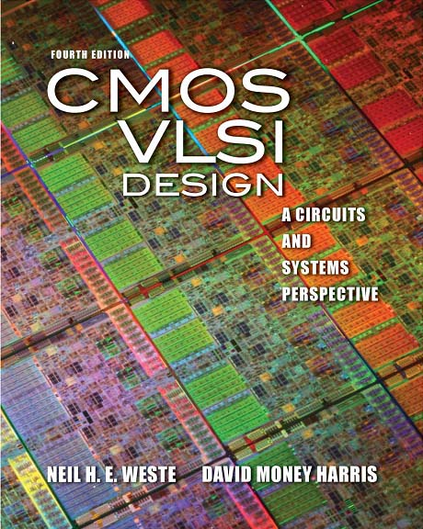
Lecture 3:
Nonideal Transistor Theory

Slide 3
Outline
Nonideal Transistor Behavior
  High Field Effects
    Mobility Degradation
    Velocity Saturation
  Channel Length Modulation
  Threshold Voltage Effects
    Body Effect
    Drain-Induced Barrier Lowering
    Short Channel Effect
  Leakage
    Subthreshold Leakage
    Gate Leakage
    Junction Leakage
Process and Environmental Variations

Slide 4
Ideal Transistor I-V
Shockley long-channel transistor models

Slide 5
Ideal vs. Simulated nMOS I-V Plot
65 nm IBM process, V_{DD} = 1.0 V

Slide 6
Electric Fields Effects
Vertical electric field: E_{vert} = V_{gs} / t_{ox}
  Attracts carriers into channel
  Long channel: Q_{channel} ∝ E_{vert}
Lateral electric field: E_{lat} = V_{ds} / L
  Accelerates carriers from drain to source
  Long channel: v = μE_{lat}

Slide 7
Channel Length Modulation
Reverse-biased p-n junctions form a depletion region
  Region between n and p with no carriers
  Width of depletion L_{d} region grows with reverse bias
  L_{eff} = L – L_{d}
Shorter L_{eff} gives more current
  I_{ds} increases with V_{ds}
  Even in saturation

Slide 8
Chan Length Mod I-V
λ = channel length modulation coefficient
  not feature size
  Empirically fit to I-V characteristics

Slide 9
Body Effect
Body is a fourth transistor terminal
V_{sb} affects the charge required to invert the channel
  Increasing V_{s} or decreasing V_{b} increases V_{t}
φ_{s} = surface potential at threshold
  Depends on doping level N_{A}
  And intrinsic carrier concentration n_{i}
γ = body effect coefficient

Slide 10
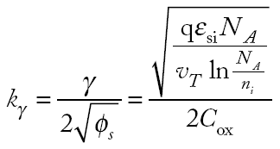
Body Effect Cont.
For small source-to-body voltage, treat as linear

Slide 11
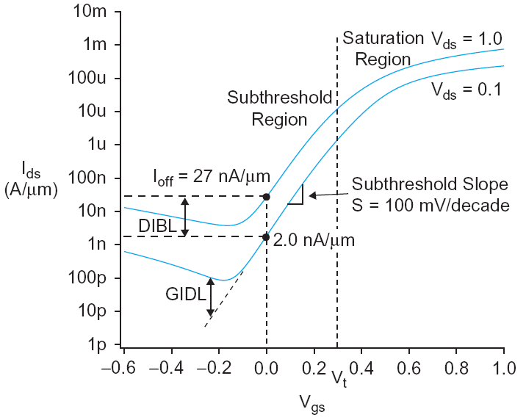
Leakage
What about current in cutoff?
Simulated results
What differs?
  Current doesn’t
  go to 0 in cutoff

Slide 12
Leakage Sources
Subthreshold conduction
  Transistors can’t abruptly turn ON or OFF
  Dominant source in contemporary transistors
Gate leakage
  Tunneling through ultrathin gate dielectric
Junction leakage
  Reverse-biased PN junction diode current

Slide 13
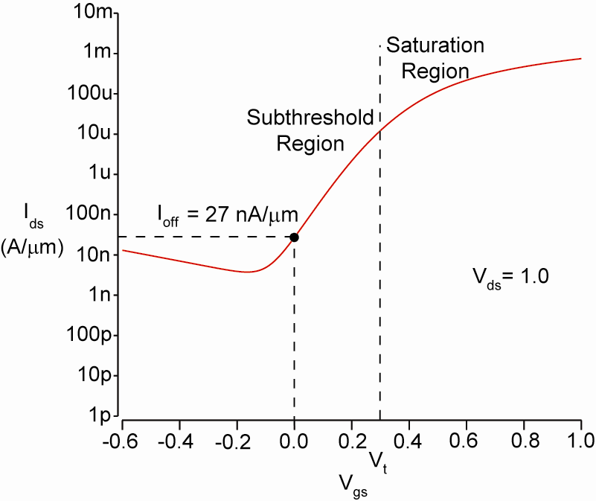
ON and OFF Current
I_{on} = I_{ds} @ V_{gs} = V_{ds} = V_{DD}
  Saturation
I_{off} = I_{ds} @ V_{gs} = 0, V_{ds} = V_{DD}
  Cutoff

Slide 14
Temperature Sensitivity
Increasing temperature
  Reduces mobility
  Reduces V_{t}
I_{ON} decreases with temperature
I_{OFF} increases with temperature

Slide 15
So What?
So what if transistors are not ideal?
  They still behave like switches.
But these effects matter for…
  Supply voltage choice
  Logical effort
  Quiescent power consumption
  Pass transistors
  Temperature of operation

Slide 16
Parameter Variation
Transistors have uncertainty in parameters
  Process: L_{eff}, V_{t}, t_{ox} of nMOS and pMOS
  Vary around typical (T) values
Fast (F)
  L_{eff}: short
  V_{t}: low
  t_{ox}: thin
Slow (S): opposite
Not all parameters are independent
for nMOS and pMOS

Slide 17
Environmental Variation
V_{DD} and T also vary in time and space
Fast:
  V_{DD}: high
  T: low
Corner | Voltage | Temperature
F | 1.98 | 0 C
T | 1.8 | 70 C
S | 1.62 | 125 C

Slide 18
Process Corners
Process corners describe worst case variations
  If a design works in all corners, it will probably work for any variation.
Describe corner with four letters (T, F, S)
  nMOS speed
  pMOS speed
  Voltage
  Temperature

Slide 19
Important Corners
Some critical simulation corners include
Purpose | nMOS | pMOS | V_{DD} | Temp
Cycle time | S | S | S | S
Power | F | F | F | F
Subthreshold leakage | F | F | F | S

Slide 20
Extra Slides

Slide 21
Coffee Cart Analogy
Tired student runs from VLSI lab to coffee cart
Freshmen are pouring out of the physics lecture hall
V_{ds} is how long you have been up
  Your velocity = fatigue × mobility
V_{gs} is a wind blowing you against the glass (SiO₂) wall
At high V_{gs}, you are buffeted against the wall
  Mobility degradation
At high V_{ds}, you scatter off freshmen, fall down, get up
  Velocity saturation
    Don’t confuse this with the saturation region

Slide 22
Mobility Degradation
High E_{vert} effectively reduces mobility
  Collisions with oxide interface

Slide 23
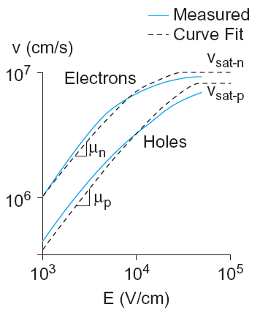
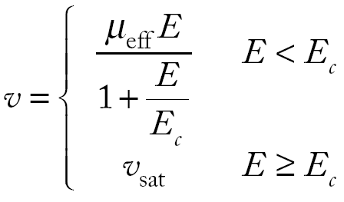
Velocity Saturation
At high E_{lat}, carrier velocity rolls off
  Carriers scatter off atoms in silicon lattice
  Velocity reaches v_{sat}
    Electrons: 10⁷ cm/s
    Holes: 8 x 10⁶ cm/s
  Better model

Slide 24
Vel Sat I-V Effects
Ideal transistor ON current increases with V_{DD}²
Velocity-saturated ON current increases with V_{DD}
Real transistors are partially velocity saturated
  Approximate with α-power law model
  I_{ds} ∝ V_{DD}^{α}
  1 < α < 2 determined empirically (≈ 1.3 for 65 nm)

Slide 25
α-Power Model

Slide 26
Threshold Voltage Effects
V_{t} is V_{gs} for which the channel starts to invert
Ideal models assumed V_{t} is constant
Really depends (weakly) on almost everything else:
  Body voltage: Body Effect
  Drain voltage: Drain-Induced Barrier Lowering
  Channel length: Short Channel Effect

Slide 27
DIBL
Electric field from drain affects channel
More pronounced in small transistors where the drain is closer to the channel
Drain-Induced Barrier Lowering
  Drain voltage also affect V_{t}
High drain voltage causes current to increase.

Slide 28
Short Channel Effect
In small transistors, source/drain depletion regions extend into the channel
  Impacts the amount of charge required to invert the channel
  And thus makes V_{t} a function of channel length
Short channel effect: V_{t} increases with L
  Some processes exhibit a reverse short channel effect in which V_{t} decreases with L

Slide 29
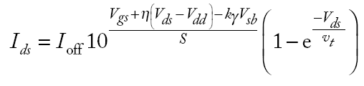
Subthreshold Leakage
Subthreshold leakage exponential with V_{gs}
n is process dependent
  typically 1.3-1.7
Rewrite relative to I_{off} on log scale
S ≈ 100 mV/decade @ room temperature

Slide 30
Gate Leakage
Carriers tunnel thorough very thin gate oxides
Exponentially sensitive to t_{ox} and V_{DD}
  A and B are tech constants
  Greater for electrons
    So nMOS gates leak more
Negligible for older processes (t_{ox} > 20 Å)
Critically important at 65 nm and below (t_{ox} ≈ 10.5 Å)
From [Song01]

Slide 31
Junction Leakage
Reverse-biased p-n junctions have some leakage
  Ordinary diode leakage
  Band-to-band tunneling (BTBT)
  Gate-induced drain leakage (GIDL)

Slide 32
Diode Leakage
Reverse-biased p-n junctions have some leakage
At any significant negative diode voltage, I_{D} = -I_{s}
I_{s} depends on doping levels
  And area and perimeter of diffusion regions
  Typically < 1 fA/μm² (negligible)

Slide 33
Band-to-Band Tunneling
Tunneling across heavily doped p-n junctions
  Especially sidewall between drain & channel
  when halo doping is used to increase V_{t}
Increases junction leakage to significant levels
  X_{j}: sidewall junction depth
  E_{g}: bandgap voltage
  A, B: tech constants

Slide 34
Gate-Induced Drain Leakage
Occurs at overlap between gate and drain
  Most pronounced when drain is at V_{DD}, gate is at a negative voltage
  Thwarts efforts to reduce subthreshold leakage using a negative gate voltage

