Slide 1
VLSI Design
ECE 09.414
CMOS VLSI Design
Adam Fifth
Henry M. Rowan College of Engineering
Department of ECE
Rowan University

Slide 2
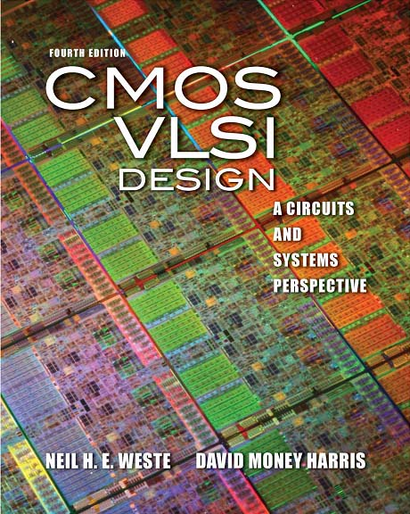
Lecture 2:
CMOS Transistor Theory

Slide 3
Outline
Introduction
MOS Capacitor
nMOS I-V Characteristics
pMOS I-V Characteristics
Gate and Diffusion Capacitance

Slide 4
Introduction
So far, we have treated transistors as ideal switches
An ON transistor passes a finite amount of current
  Depends on terminal voltages
  Derive current-voltage (I-V) relationships
Transistor gate, source, drain all have capacitance
  I = C (ΔV/Δt) -> Δt = (C/I) ΔV
  Capacitance and current determine speed

Slide 5
MOS Capacitor
Gate and body form MOS capacitor
Operating modes
  Accumulation
  Depletion
  Inversion
Notes:
Lecture 4:

Slide 6
Terminal Voltages
Mode of operation depends on V_{g}, V_{d}, V_{s}
  V_{gs} = V_{g} – V_{s}
  V_{gd} = V_{g} – V_{d}
  V_{ds} = V_{d} – V_{s} = V_{gs} - V_{gd}
Source and drain are symmetric diffusion terminals
  By convention, source is terminal at lower voltage
  Hence V_{ds} ≥ 0
nMOS body is grounded. First assume source is 0 too.
Three regions of operation
  Cutoff
  Linear
  Saturation

Slide 7
nMOS Cutoff
No channel
I_{ds} ≈ 0

Slide 8
nMOS Linear
Channel forms
Current flows from d to s
  e⁻ from s to d
I_{ds} increases with V_{ds}
Similar to linear resistor

Slide 9
nMOS Saturation
Channel pinches off
I_{ds} independent of V_{ds}
We say current saturates
Similar to current source

Slide 10
I-V Characteristics
In Linear region, I_{ds} depends on
  How much charge is in the channel?
  How fast is the charge moving?

Slide 11
Channel Charge
MOS structure looks like parallel plate capacitor while operating in inversions
  Gate – oxide – channel
Q_{channel} = CV
C = C_{g} = ε_{ox}WL/t_{ox} = C_{ox}WL
V = V_{gc} – V_{t} = (V_{gs} – V_{ds}/2) – V_{t}
C_{ox} = ε_{ox} / t_{ox}

Slide 12
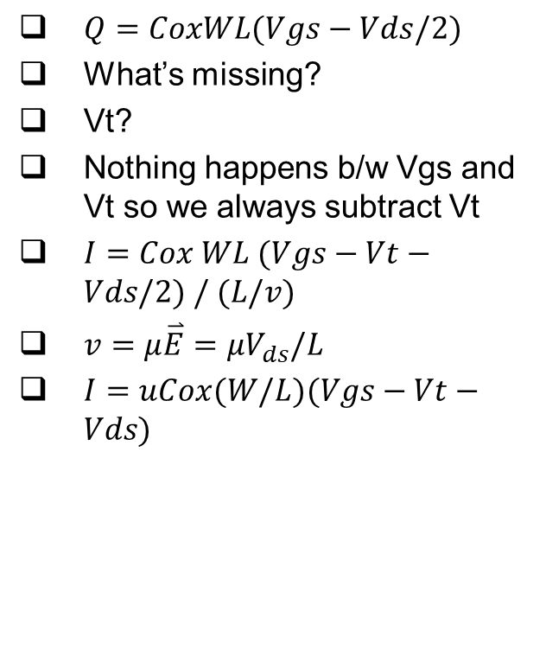
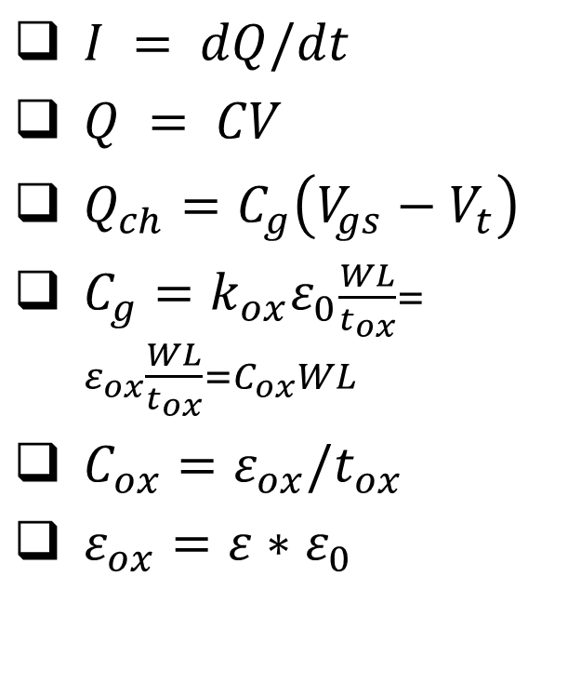
Long Channel I-V
$I = dQ/dt$
$Q = CV$
$Q_{ch}=C_{g}\left(V_{gs}−V_{t}\right)$
$C_{g}=k_{ox}ε_{0}\frac{WL}{t_{ox}}=ε_{ox}\frac{WL}{t_{ox}}=C_{ox}WL$
$C_{ox}=ε_{ox}/t_{ox}$
$ε_{ox}=ε∗ε_{0}$
$Q=CoxWL(Vgs−Vds/2)$
What’s missing?
Vt?
Nothing happens b/w Vgs and Vt so we always subtract Vt
$I=Cox WL (Vgs−Vt−Vds/2) / (L/v)$
$v=μ\overset{⃑}{E}=μV_{ds}/L$
$I=uCox(W/L)(Vgs−Vt−Vds)$

Slide 13
Carrier velocity
Charge is carried by e-
Electrons are propelled by the lateral electric field between source and drain
  E = V_{ds}/L
Carrier velocity v proportional to lateral E-field
  v = μE μ called mobility
Time for carrier to cross channel:
  t = L / v
Notes:
CH 2 pg 66

Slide 14
nMOS Linear I-V
Now we know
  How much charge Q_{channel} is in the channel
  How much time t each carrier takes to cross

Slide 15
nMOS Saturation I-V
If V_{gd} < V_{t}, channel pinches off near drain
  When V_{ds} > V_{dsat} = V_{gs} – V_{t}
Now drain voltage no longer increases current

Slide 16
nMOS I-V Summary
Shockley 1st order transistor models

Slide 17
Example
We will be using a 0.6 μm process for your project
  From AMI Semiconductor
  t_{ox} = 100 Å
  μ = 350 cm²/V*s
  V_{t} = 0.7 V
Plot I_{ds} vs. V_{ds}
  V_{gs} = 0, 1, 2, 3, 4, 5
  Use W/L = 4/2 λ

Slide 18
pMOS I-V
All dopings and voltages are inverted for pMOS
  Source is the more positive terminal
Mobility μ_{p} is determined by holes
  Typically 2-3x lower than that of electrons μ_{n}
  120 cm²/V•s in AMI 0.6 μm process
Thus pMOS must be wider to
provide same current
  In this class, assume
  μ_{n} / μ_{p} = 2

Slide 19
Capacitance
Any two conductors separated by an insulator have capacitance
Gate to channel capacitor is very important
  Creates channel charge necessary for operation
Source and drain have capacitance to body
  Across reverse-biased diodes
  Called diffusion capacitance because it is associated with source/drain diffusion

Slide 20
Gate Capacitance
Approximate channel as connected to source
C_{gs} = ε_{ox}WL/t_{ox} = C_{ox}WL = C_{permicron}W
C_{permicron} is typically about 2 fF/μm
Notes:
“Chapter 2: Long channel I-V characteristics” in book

Slide 21
Diffusion Capacitance
C_{sb}, C_{db}
Undesirable, called parasitic capacitance
Capacitance depends on area and perimeter
  Use small diffusion nodes
  Comparable to C_{g}
  for contacted diff
  ½ C_{g} for uncontacted
  Varies with process

