Slide 1
VLSI Design
ECE 09.414
CMOS VLSI Design
Adam Fifth
Henry M. Rowan College of Engineering
Department of ECE
Rowan University

Slide 2
Course Summary
CMOS: Circuits, Fabrication and Layout Design Rules (Chapters 1 & 3) 2 Weeks
MOS Transistor Theory (Chapter 2) 1.5 Weeks
Delay - DC and Transient Response (Chapter 4) 3 Weeks
Examination # 1
Power (Chapters 5) 0.5 Week
Interconnect (Chapter 6) 1 Week

Slide 3
Course Summary
Robustness and Transistor Scaling (Chapter 7)
2 Weeks
7. Circuit Simulation (Chapter 8) 0.5 Week
Examination # 2
8. CMOS Logic and Circuit Design (chapter 9) 1 Week
9. Memories and Array Structures (Chapter 12) 1 Week
Final Examination

Slide 4
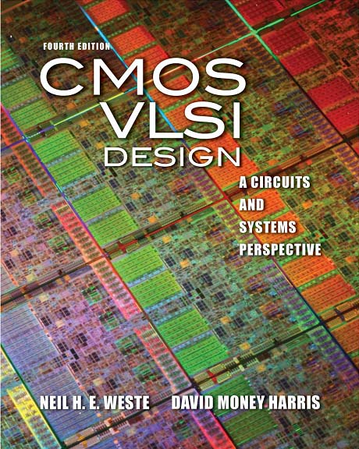
Chapter 1:
Introduction
MOS Transistors

Slide 5
Outline
A Brief History
MOS Transistors

Slide 6
A Brief History

Slide 7
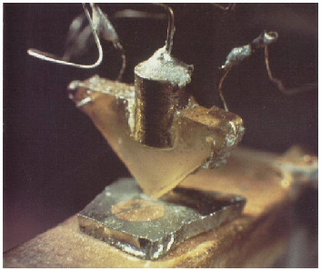
Invention of the Transistor
Vacuum tubes ruled in first half of 20th century Large, expensive, power-hungry, unreliable
1947: first point contact transistor
  John Bardeen and Walter Brattain at Bell Labs
  See Crystal Fire
  by Riordan, Hoddeson
AT&T Archives. Reprinted with permission.

Slide 8
Transistor Types
Bipolar transistors
  npn or pnp silicon structure
  Small current into very thin base layer controls large currents between emitter and collector
  Base currents limit integration density
Metal Oxide Semiconductor Field Effect Transistors
  nMOS and pMOS MOSFETS ➔ CMOS
  Voltage applied to insulated gate controls current between source and drain
  Low power allows very high integration

Slide 9
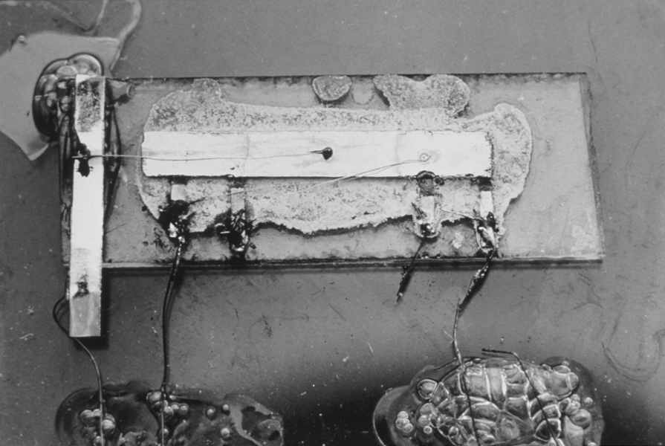
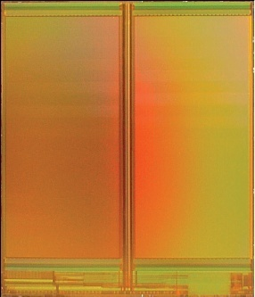
Integrated Circuit
1958: First integrated circuit
  Bipolar
  Flip-flop using two transistors
  Built by Jack Kilby at Texas Instruments
2010
  CMOS
  Intel Core i7 μprocessor
    2.3 billion transistors
  64 Gb Flash memory
    > 16 billion transistors
Courtesy Texas Instruments
[Trinh09]
© 2009 IEEE

Slide 10
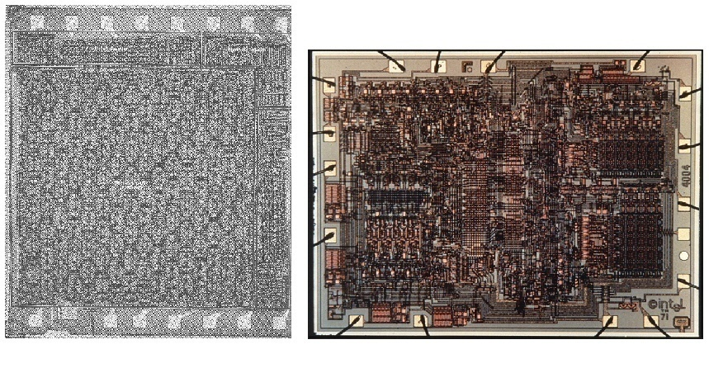
MOS Integrated Circuits
1970’s processes usually had only nMOS transistors
  Inexpensive, but consume power while idle
1980s-present: CMOS processes for low idle power
Intel 1101 256-bit SRAM
Intel 4004 4-bit μProc

Slide 11
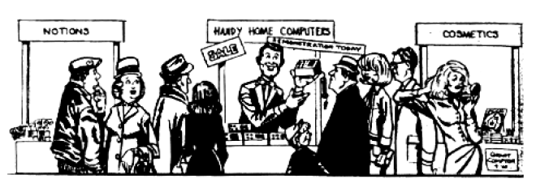
Growth Rate
53% compound annual growth rate over 50 years
  No other technology has grown so fast so long
Driven by miniaturization of transistors
  Smaller is cheaper, faster, lower in power!
  Revolutionary effects on society
[Moore65]
Electronics Magazine

Slide 12
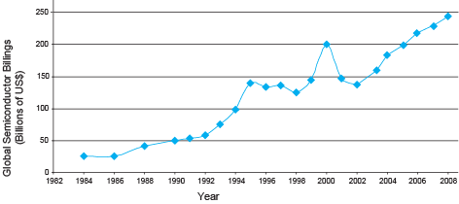
Annual Sales
>10¹⁹ transistors manufactured in 2008
  1 billion for every human on the planet

Slide 13
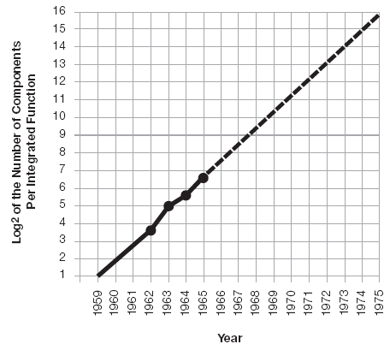
Moore’s Law: Then
1965: Gordon Moore plotted transistor on each chip
  Fit straight line on semilog scale
  Transistor counts have doubled every 26 months
Integration Levels
SSI: 10 gates
MSI: 1000 gates
LSI: 10,000 gates
VLSI: > 10k gates
[Moore65]
Electronics Magazine

Slide 14
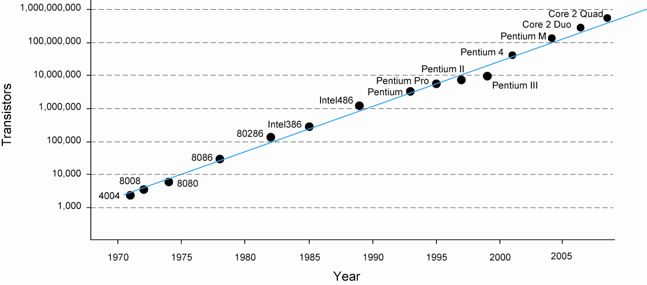
And Now…

Slide 15
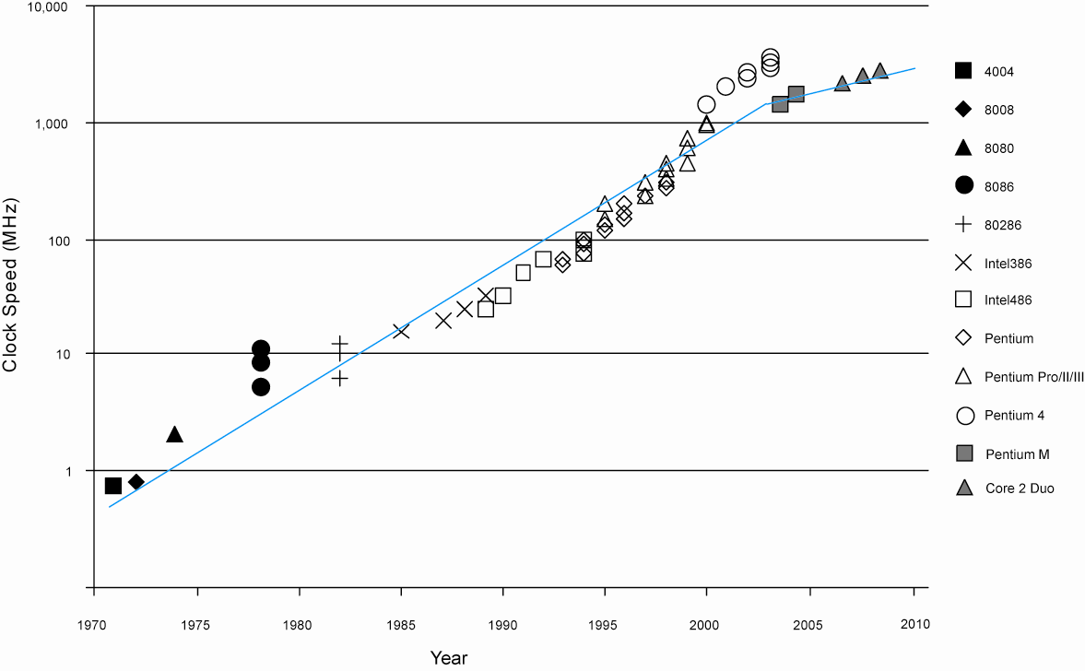
Corollaries
Many other factors grow exponentially
  Ex: clock frequency, processor performance

Slide 16

Just Imagine
If the automobile industry had made the same progress as the semiconductor industry, a car today would:
- Cost: around $0.16
- Perf: be able to do 25,000 miles per hour
- Power: get 1,500 miles per gallon
- Density: seat 400,000 People

Slide 17
MOS Transistors

Slide 18
Introduction
Integrated circuits: many transistors on one chip.
Very Large Scale Integration (VLSI): bucketloads!
Complementary Metal Oxide Semiconductor
  Fast, cheap, low power transistors
First: How to build a simple CMOS chip
  CMOS transistors
  Building logic gates from transistors
  Transistor layout and fabrication
Rest of the course: How to build a good CMOS chip

Slide 19
Silicon Lattice
Transistors are built on a silicon substrate
Silicon is a Group IV material
Forms crystal lattice with bonds to four neighbors

Slide 20
Dopants
Silicon is a semiconductor
Pure silicon has no free carriers and conducts poorly
Adding dopants increases the conductivity
Group V: extra electron (n-type)
Group III: missing electron, called hole (p-type)

Slide 21
p-n Junctions
A junction between p-type and n-type semiconductor forms a diode.
Current flows only in one direction

Slide 22
nMOS Transistor
Four terminals: gate, source, drain, body
Gate – oxide – body stack looks like a capacitor
  Gate and body are conductors
  SiO₂ (oxide) is a very good insulator
  Called metal – oxide – semiconductor (MOS) capacitor
  Even though gate is
  no longer made of metal*
* Metal gates are returning today!

Slide 23
nMOS Operation
Body is usually tied to ground (0 V)
When the gate is at a low voltage:
  P-type body is at low voltage
  Source-body and drain-body diodes are OFF
  No current flows, transistor is OFF

Slide 24
nMOS Operation Cont.
When the gate is at a high voltage:
  Positive charge on gate of MOS capacitor
  Negative charge attracted to body
  Inverts a channel under gate to n-type
  Now current can flow through n-type silicon from source through channel to drain, transistor is ON

Slide 25
pMOS Transistor
Similar, but doping and voltages reversed
  Body tied to high voltage (V_{DD})
  Gate low: transistor ON
  Gate high: transistor OFF
  Bubble indicates inverted behavior

Slide 26
Power Supply Voltage
GND = 0 V
In 1980’s, V_{DD} = 5V
V_{DD} has decreased in modern processes
  High V_{DD} would damage modern tiny transistors
  Lower V_{DD} saves power
V_{DD} = 3.3, 2.5, 1.8, 1.5, 1.2, 1.0, …

Slide 27
Transistors as Switches
We can view MOS transistors as electrically controlled switches
Voltage at gate controls path from source to drain

Slide 28
Summary
MOS Transistors are stack of gate, oxide, silicon
Can be viewed as electrically controlled switches

