Slide 1
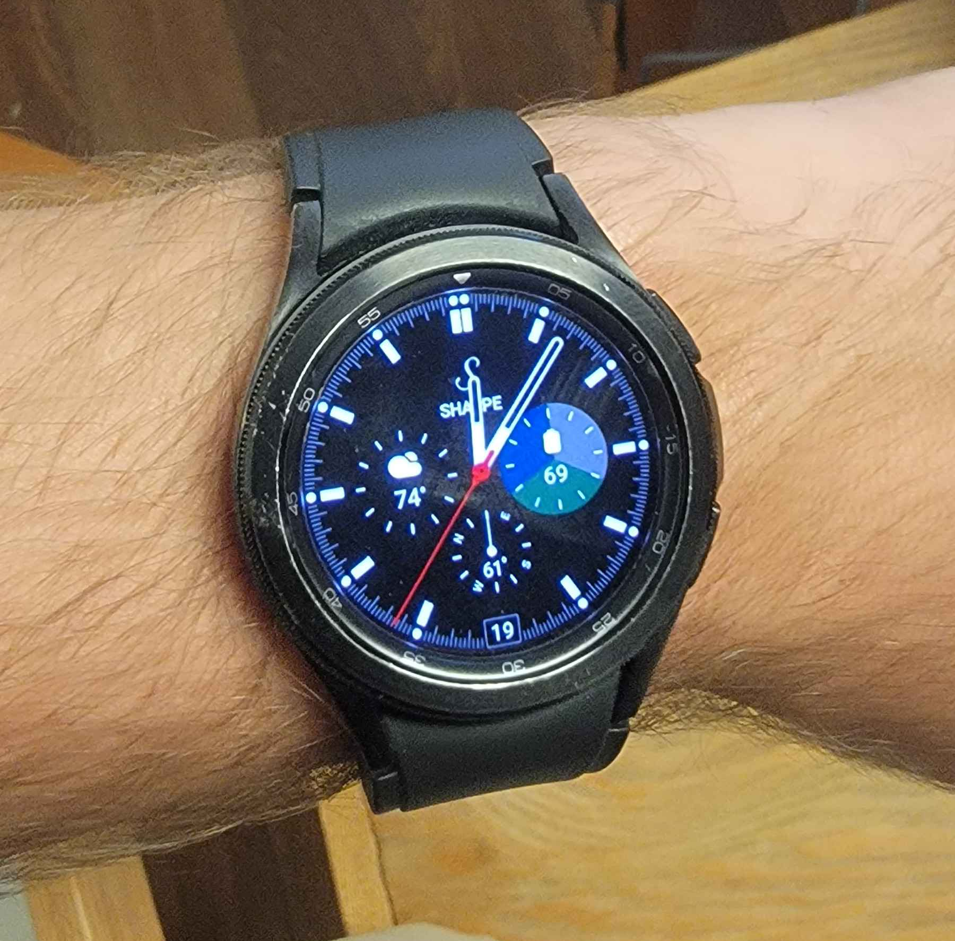
Galaxy Watch 4 Classic
Gathers data from an array of sensors
Computes and tracks various activities and bio-metrics
Communicates over Bluetooth
Notifies the wearer about activity changes and reminders

Slide 2
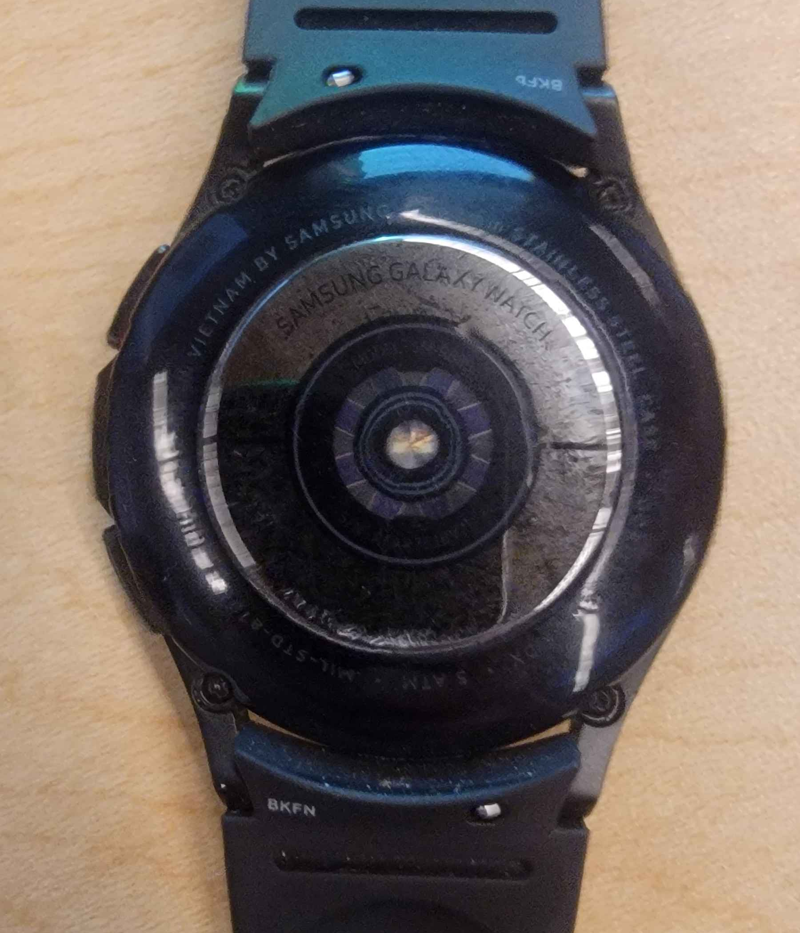
Galaxy Watch 4 Classic
Accelerometer
Barometer
Gyro
Geo-magnetics
Electrical heart sensor (ECG)
Optical heart rate sensor (HRM)
Bio-electrical impedance analysis sensor
Light sensor
Hall sensor

Slide 3
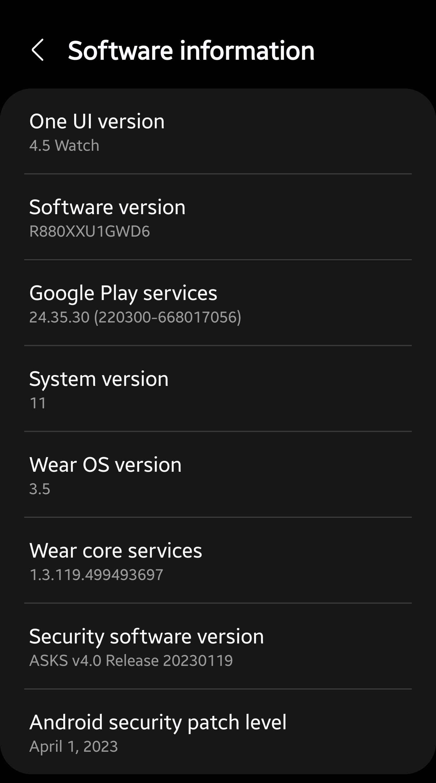
Galaxy Watch 4 Classic
Software Version: R880XXU1GWD6
Wear OS Version: 3.5
System version: 11
Security software version:
ASKS v4.0 Release 202230119
Processor: Exynos W920 SoC

