Slide 1
Addressing the Gap
Physical Cybersecurity & Operational Technology
A 501(c)(6) organization established on Feb 21, 2020

Slide 2
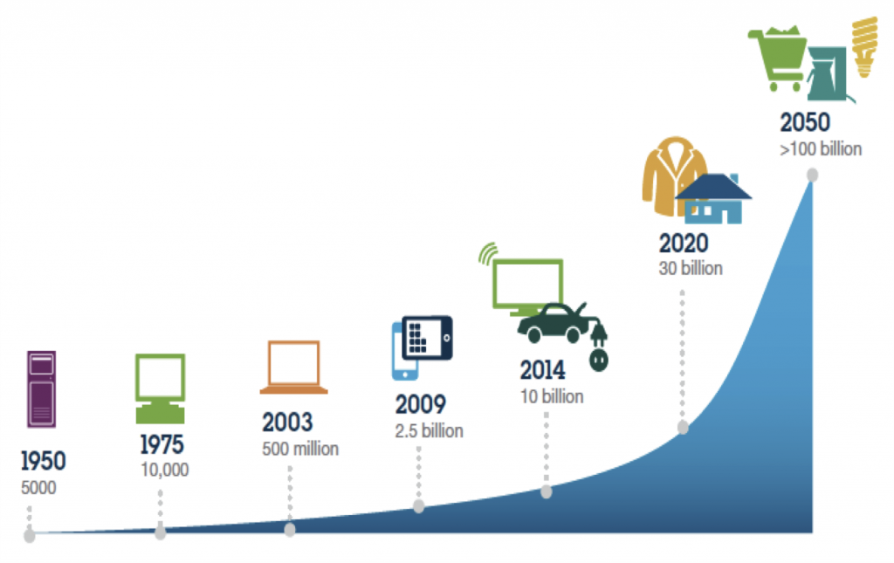
The Problem & Those at Risk
STAKEHOLDERS WITH RISK
Known & Expanding Threats to Physical Safety
Critical infrastructure, utilities, facilities, schools, homes
Widening Range of Interfaces
Artificial intelligence, machine learning, robots, smarter technologies, automation
National Intelligence
Compromised control system list growing & posing national risk
Increasing Sophistication of Bad Actors
Increasing sophistication of bad actors (nation-state, terrorists, criminals, hackers)
Smart device vendors/installers
Building owners/operators
Mortgage Lenders
Rating agencies
Control systems manufacturers
Insurance companies
Cyber services companies
Protecting “things” is very different than protecting PCs

Slide 3
INSURANCE
COMPANIES
RATING
AGENCIES
MORTGAGE
LENDERS
Seeking an accepted market standard by which to graduate levels of coverage and fees for clients
Standard and Poor’s, Moody’s and others recognizing the threat of citizen safety in real estate and with devices and the threat of lawsuits and negative publicity will look for a market standard to assist their company ratings
Will look for levels of physical cyber security as they currently look for fire/life/safety compliance
EXTERNAL STAKEHOLDERS
REQUIRE ACCEPTED MARKET STANDARD
3

Slide 4


EVERY WAY OUT
IS A WAY IN!

Slide 5




DEVICES
A hacker used a Smart TV as a “home base” to infect an entire house through its router. Hacker could access cameras on any device for live viewing, all device speakers for listening, monitor internet traffic and had access to any new device that connected to the network.
5

Slide 6



VEHICLES
Jeep tested their own vehicles. They could start or kill the engine, make the car speed up, slow down, brake, randomly deploy airbags, control the entire entertainment system and access and hack any devices connected to the entertainment system such as phones or wearables.
6

Slide 7
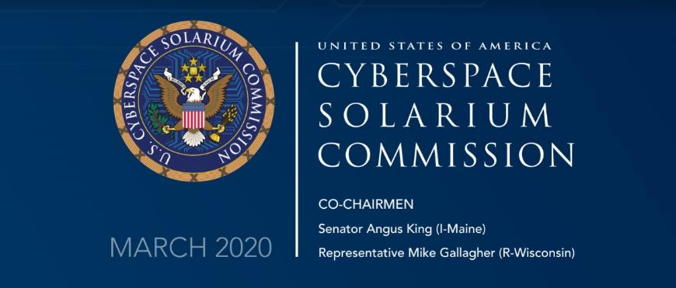
U.S. Response
Pillar 1
Reform the U.S. Government’s Structure and Organization for Cyberspace.
Pillar 2
Strengthen Norms and Non-military Tools.
Pillar 3
Promote National Resilience.
Pillar 4
Reshape the Cyber Ecosystem toward Greater Security.
Pillar 5
Operationalize Cybersecurity Collaboration with the Private Sector.
Pillar 6
Preserve and Employ the Military Instrument of Power—and All Other Options to Deter Cyberattacks at any level.

Slide 8
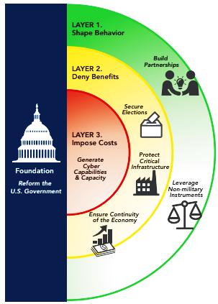

Private Sector
Layer 1
Shape Behavior
Desired End State
Reduce the frequency & severity of physical cyber attacks.
Limit the ability of great powers, rogue states, extremists, and criminals to undetermined American power and influence.
Layered Physical Cyber Deterrence
Defend Forward
concurrent, continuous, collaborative

Slide 9
Our Mission
Current Risk Mitigation & BCS Focus
Establish and maintain tailored frameworks administered by a non-profit organization that offers market driven options developed by stakeholders for Cybersecure operational technology systems and devices to improve physical security, safety, & privacy
Current Risk Mitigation (limited)
Cyber rating assessments
Hire cyber defense companies to run systems
Gov't regulatory policy
Cyber standards organization non-coordination
Engineering improvements/investments
Educate/Train (Cyber Hygiene, Awareness)
The BCS Framework is focused on increasing the asset value, while facilitating incentives for the comprehensive enhancement of technology, processes, & training to respond to a rapidly, evolving global threat.

Slide 10
Does a framework already exist?

Slide 11




Existing Frameworks
Proposed BCS
ISA/IES 62443
DoD Model
DoE Maturity (C2M2)
NIST Tier Model
BRONZE
SILVER
GOLD
PLATINUM
Maturity 1
Maturity 2
Maturity 3
Maturity 4
Basic
Intermediate
Good
Proactive
Advanced
Level 0
Level 1
Level 2
Level 3
Partial
Risk Informed
Repeatable
Adaptive

Slide 12
Harmonize Frameworks and Incentivize Private Industry Adoption
Standards Consolidation
Consolidation of standards already in public domain
Dynamic Threat
Framework designed to provide value for entire system lifecycle due to evolving threat
Adaptive Model
Framework will evolve to meet changing threats
Recertification
Evolving threat environment requires on-going education
Assessment
Provide parameters for third party assessment of facilities based on framework scoring metrics
Tenant Rating
Public or private - Owner discretion

Slide 13



Value Proposition for Key Stakeholders
CRE OWNERS & OPERATORS
Options to choose security level of investment to meet stakeholder requirements
Clearly defined operating costs to meet insurance company discounts for assets under their control, as well as occupants
TECHNOLOGY COMPANIES
OT platforms with established baselines and committed service levels across industries
Product and technology data based on the BCS framework to support investment decisions
INSURERS, LENDERS, & INVESTORS
A standardized framework for insurers, lenders, and investors to facilitate physical cyber risk assessments and set differentiated fee structures and investment grade ratings
Real estate platforms recognized at each certification level in terms of ability to safely offer an array of smart technology management services

Slide 14
Benefits of Protecting Building Management Systems
As smart technology services expand, new safety and protection services will be required.
Protecting building management systems will reduce risks to:
Life, Safety, Health –Protection of Employees & Visitors
Business Interruption/Decline
Bad Actions or Errors from Employees
Brand Value
Outside Takeover of Operational Systems

Slide 15
HOW TO GET INVOLVED
Membership
Advisory Board Level
Board of Directors

Slide 16
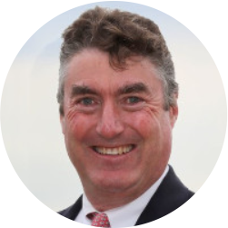
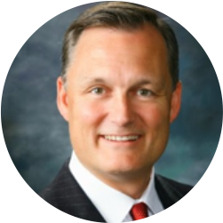
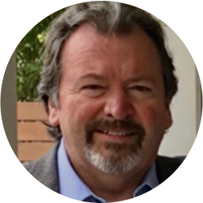

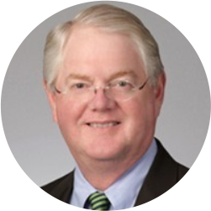

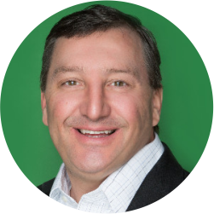
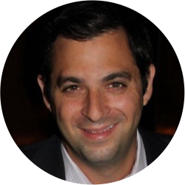
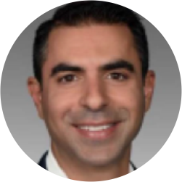


Board of Directors
Michael Dufour
BCS & 5G LLC
BoD Chairman & General Counsel
Jason Lund
BCS
CEO & Vice Chairman Advisory Board
Rick Varnell
BCS & 5G LLC
Advisory Board Chairman Partner
Matt Davis
5G LLC
CEO
John Fleury
5G LLC
EVP, Corporate Development
Greg Kiley
Kiley & Associates
CEO
EJ von Schaumburg
Digitalware
VP, Business Development
Dan Singer
Digitalware
CEO
Amir Elbaz *
BeyondEdge
CEO
Jason Christman *
Johnson Controls
Chief Product Security Officer
James Trainor *
Aon
Senior Vice President, Cyber Solutions
*Non-Founding Member

Slide 17
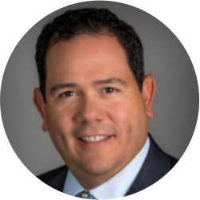

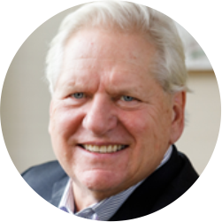

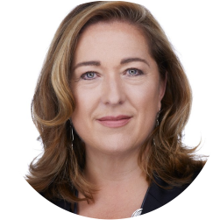

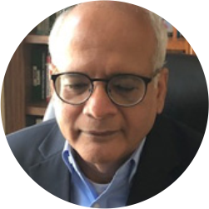
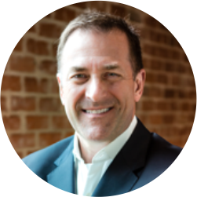

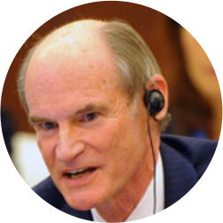
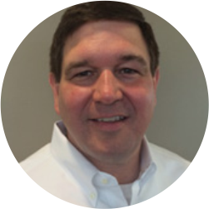
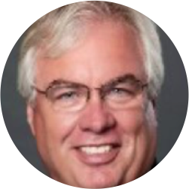

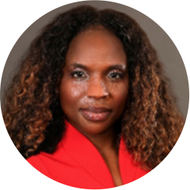
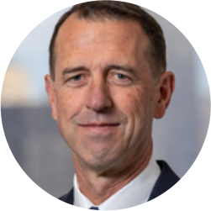

Advisory Board
Rick Varnell
BCS & 5G LLC
Jason Lund
BCS
Antonio Acevedo
Healthpeak Properties
Matt Davis
5G LLC
Ian Davis
DavisCraig
Telecommunications & Technology Law
John J. Gilbert III
Rudin Management Company
Ben Grippi
Metlife Investment Management
Equity Strategies Group
Karen Hargarther Thomas, FAIA
Gensler
Michael Kirby
Invesco
Sanjay Kumar
AT&T (Retired)
Anthony W. Long
CLX Ventures
Joseph Markling
USAA Real Estate
Bruce McConnell
EastWest Institute
John Morgan
Facebook Connectivity
Kieran Nolan
The Nolan Group
Admiral (Ret.) Bill A. Owens
Red Bison Advisory Group
Onay Payne
Clarion Partners
Admiral (Ret.) John Richardson
USN
Admiral (Ret.) Mike Rogers
National Security Agency (NSA)

Slide 18

Thank you.

