Slide 1

GAZEploit
Key Logging using Eye Tracking Data
GAZEploit
Aidan Sharpe
Image Credit: CNET - Apple Vision Pro, One Month Later: It's in My Life, Sometimes

Slide 2
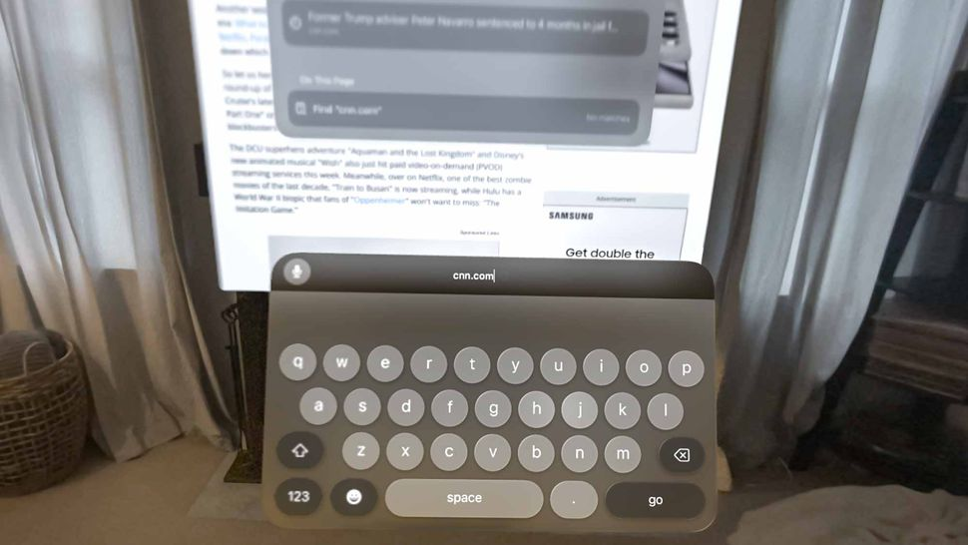
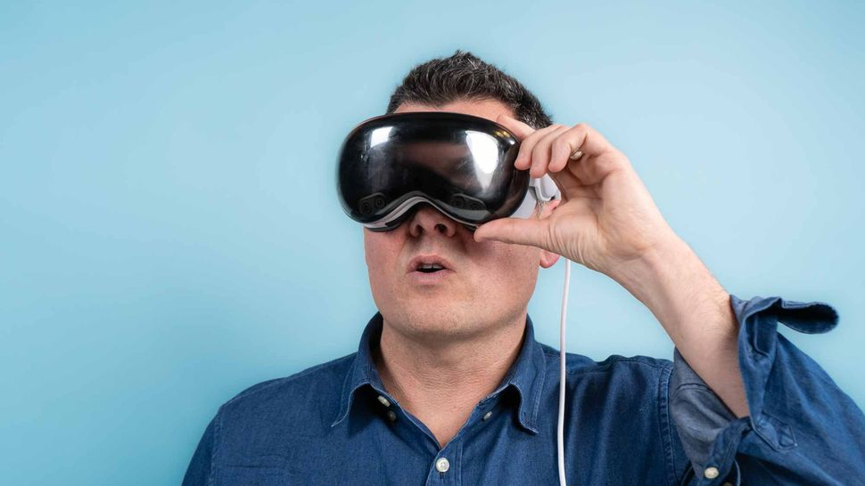
Apple Vision Pro
Image Credit: Tom’s Guide - Apple Vision Pro review: A revolution in progress

Slide 3
The Vulnerability
Avatar movements
Eye tracking information
Text reconstruction
Key logging
Notes:
When in video conferencing calls, the user will likely use an avatar provided by the Vision Pro
The movements of the avatar can expose facial biometrics
Using a machine learning model trained on avatar movements, typed text can be reconstructed
This is akin to keylogging

Slide 4
Potential Impact
Passwords
Personal information
Pins
Email & message content

Slide 5
Solutions
Persona is suspended while typing
Fixed as of visionOS 1.3

Slide 6
References
WIRED: Apple Vision Pro’s Eye Tracking Exposed What People Type
Apple: About the security content of visionOS 1.3
Tom’s Guide: Apple Vision Pro review: A revolution in progress

