Slide 1


Get Fit, Stay Lit, With RUFit.
By: Gabriella Randazzo, Kathryn Meehan, Stefan Simon, Tanish Jain, Aidan Sharpe

Slide 2
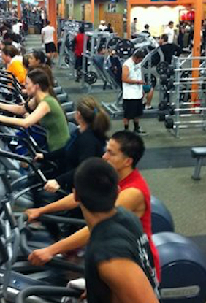


Problem Statement
Sources
Positive relationships between physical activity and mental health
  Positive academic performance
Lack of integration in lifestyle
  65% of students engage in regular vigorous in high school
  Only 38% of college students
Intimidation due to a lot of people at the gym
  47% of gym goers admit to feelings of intimidation
Spending too much time at the gym
  10% of gym time waiting for equipment

Slide 3
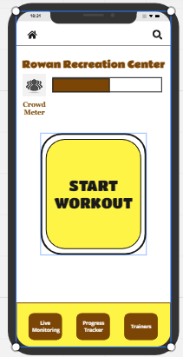
Solution Statement
College students often face problems with machine availability at the on campus-gyms, preventing them from working out as often as they like.
We are installing a sensor on machines in the gym to be able to track when machines are being used. When activated, the app will tell users which equipment is in use. Our app will also allow students to track their progress for the equipment offered in the gym, which is not offered in common college gym apps.
Increase in Confidence
Less intimidated by a busy gym
Improving Time Management
More efficient workouts, less time in the gym
Increase Gym Activity
Progress tracking to maintain fitness goals
An application designed to improve the physical health of college students is viable, considering the prevalent smartphone usage within this demographic.

