Slide 1
Low-Res Prototyping
Aidan Sharpe

Slide 2
Prototyping
Mock-up of a design
Physical description of how something works
Test design
Iterate on shortcomings

Slide 3
Low-Res vs. High-Res
Low-Res Prototypes
Gets the idea across
Bare bones
Made from available materials
High-Res Prototypes
Close to final design
Very fleshed-out
Higher-quality design

Slide 4
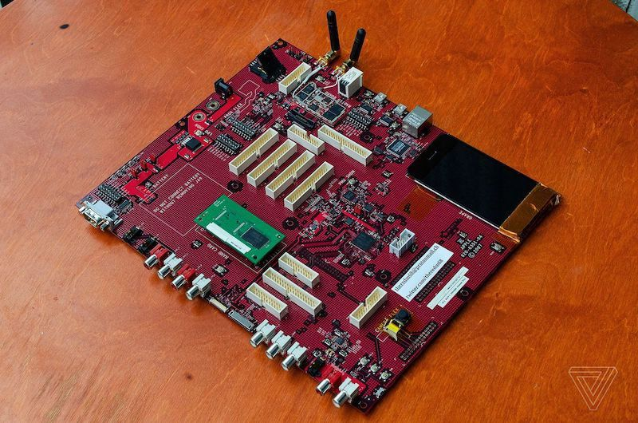
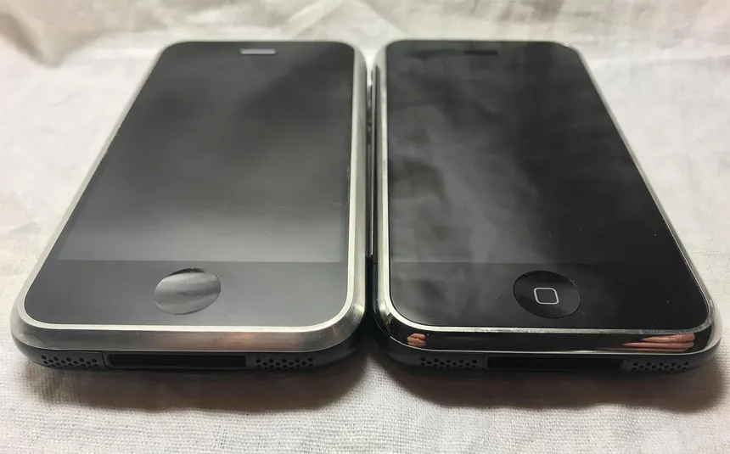
From Low-Res to High-Res
Separate form from function
  Focus on each individually
Slowly merge form and function
Original iPhone Development Board
Later Prototype iPhones

Slide 5
Personal Application
Engineering requires lots of ideas quickly
  Most ideas won’t work
  Low-res means low cost of failure
  Low-res means less time investment

Slide 6
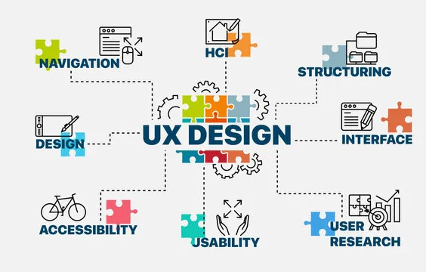
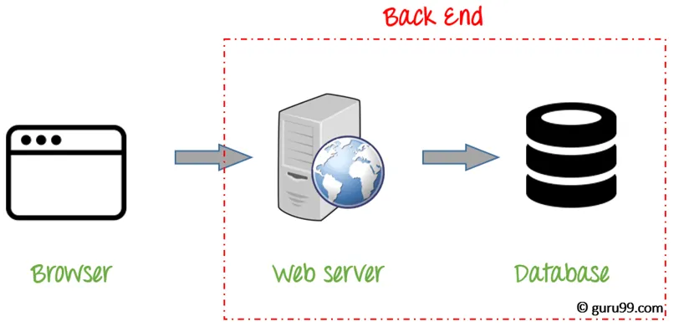
Real-World Application – Website Design
Form vs. Function
  Specialized UX design team
  Specialized back-end development team
Merge UX and back-end for high-res prototype
  Issues will be encountered in merging
  Iterate on shortcomings
  Work towards a common goal

Slide 7
Challenges
Lack of detail
Potential for misinterpretation/miscommunication
Limited feedback
Requires imagination

Slide 8
Potential Solutions
Demonstrate form and function and how they might work together
Choose words carefully when presenting
Encourage focused feedback towards specific design teams

Slide 9
Inclusivity and Accesibility
Focus on ease-of-use
Should be intuitive
  Clear labels and icons
  Things look like they should do what they actually do
Think about the target audience
  Disabilities
  Level of education
  Level of effort

Slide 10
Conclusions
Form
  Ease-of-use
  Overall look and feel
Function
  Proof of concept
  Easy to modify and iterate features
Integrating
  Make design decisions that make it easy to put form and function together

