Slide 1
Monophonic Synthesizer
Aidan Sharpe & Elise Heim

Slide 2
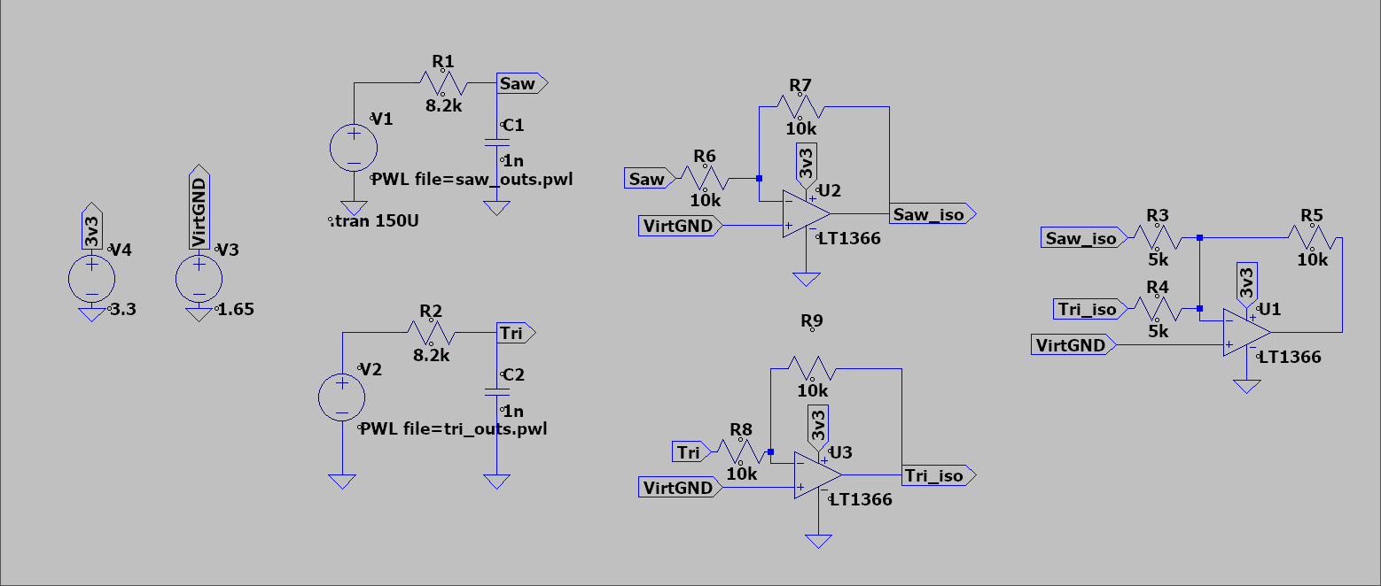
Analysis

Slide 3
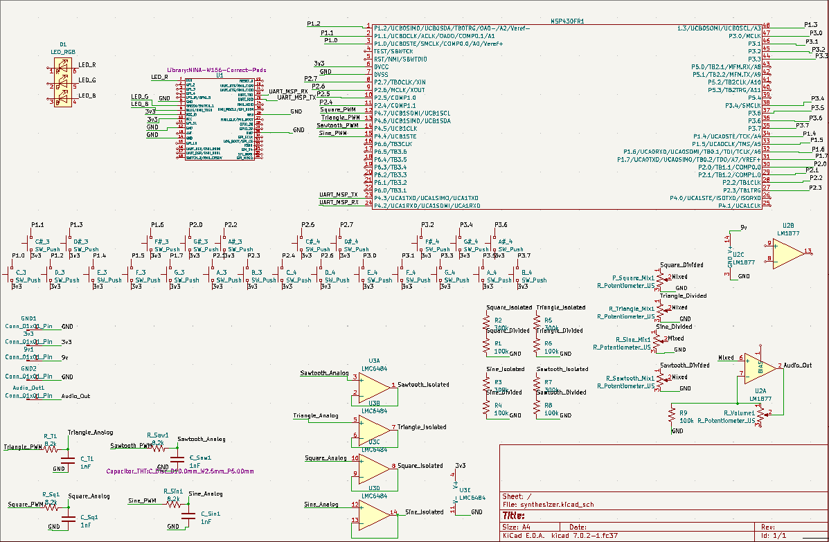
Full KiCAD Schematic

Slide 4
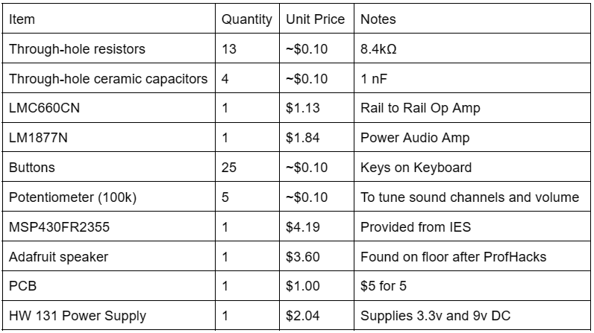
BoM

Slide 5
Simulating the PWM DAC

Slide 6
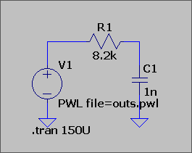
RC Low Pass Filter
ω₀= 1/(2πR₁C₁)=20 kHz

Slide 7
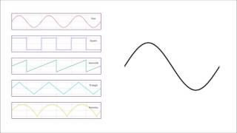
Basic Waveforms

Slide 8
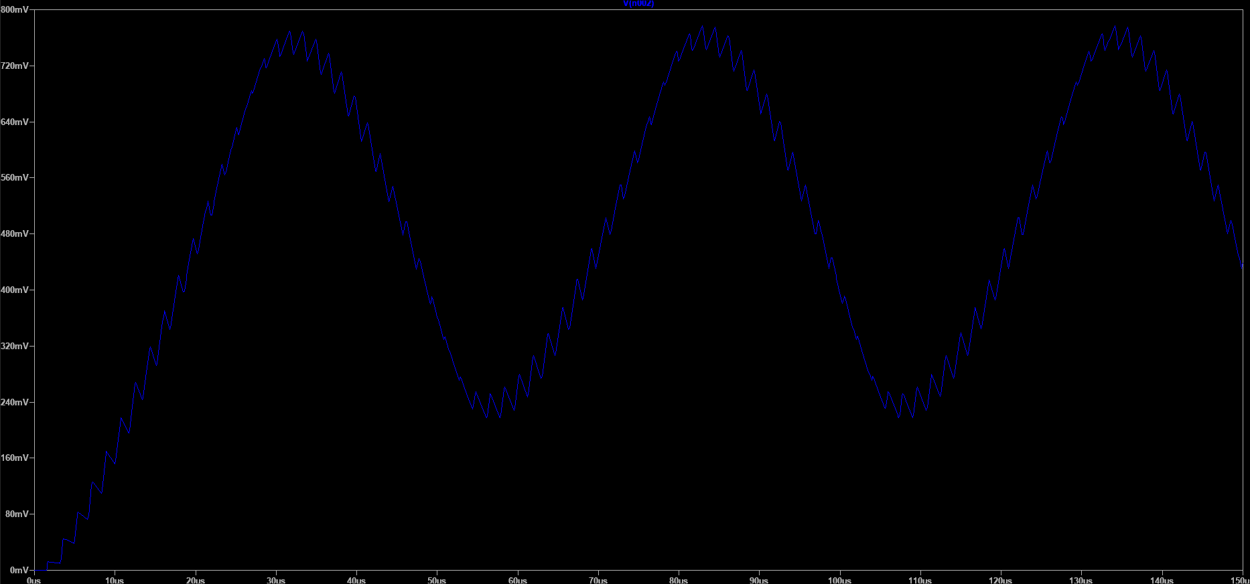
Triangle Wave

Slide 9
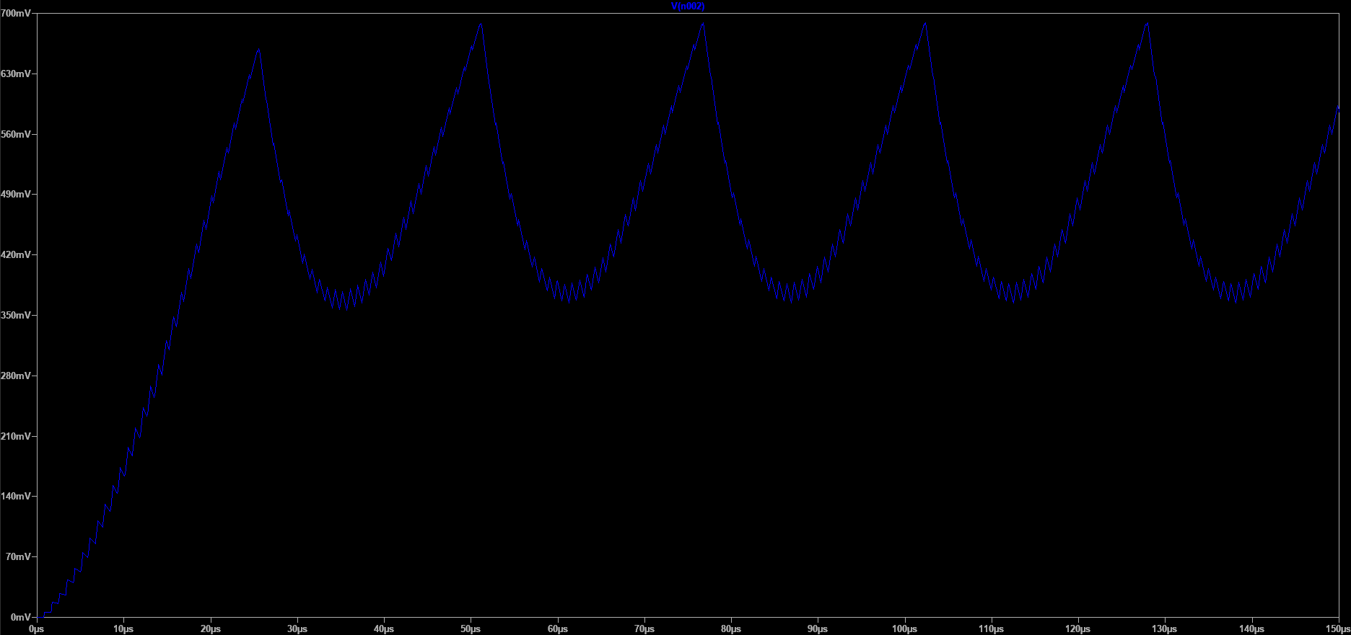
Sawtooth Wave

Slide 10
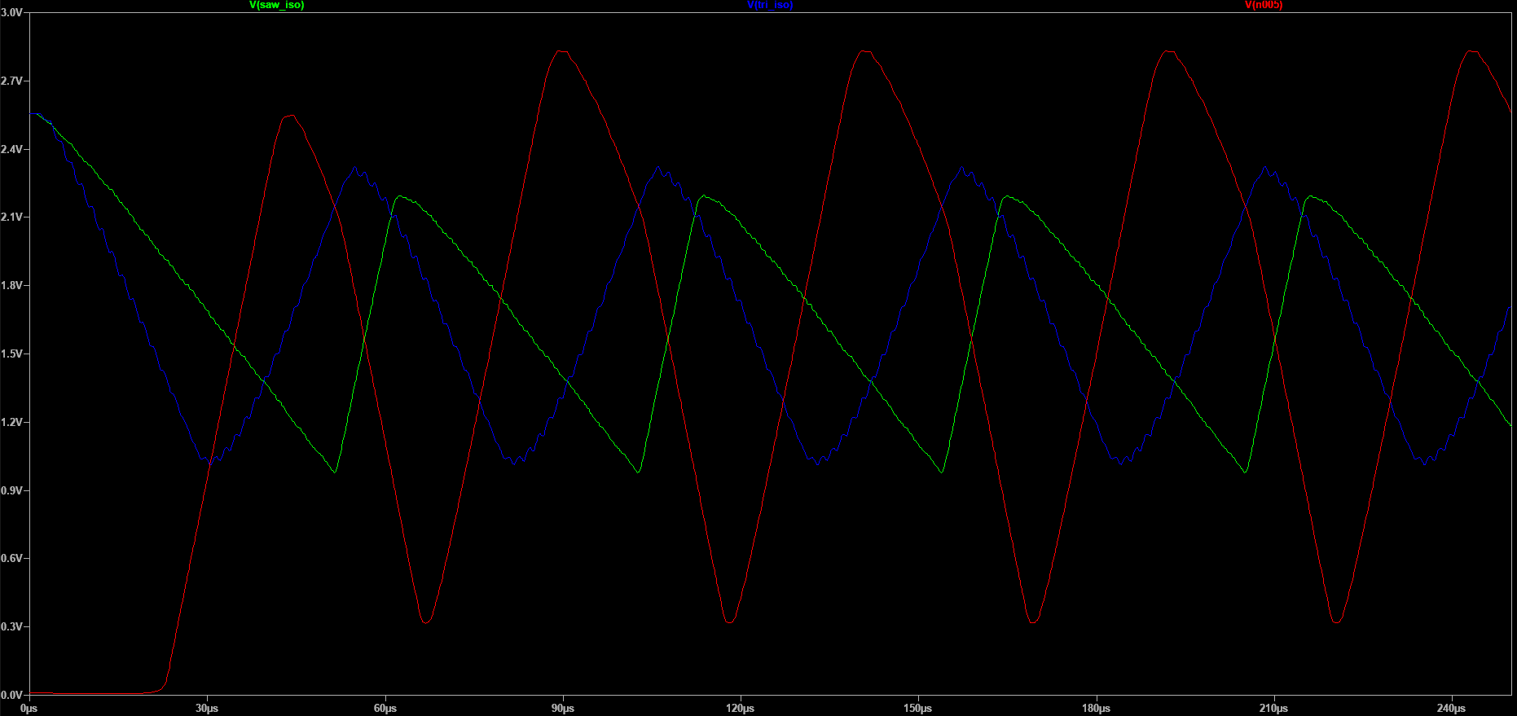
You’re Giving Me Mixed Signals
Notes:
Blue: Tri, Green: Saw, Red: mix

Slide 11
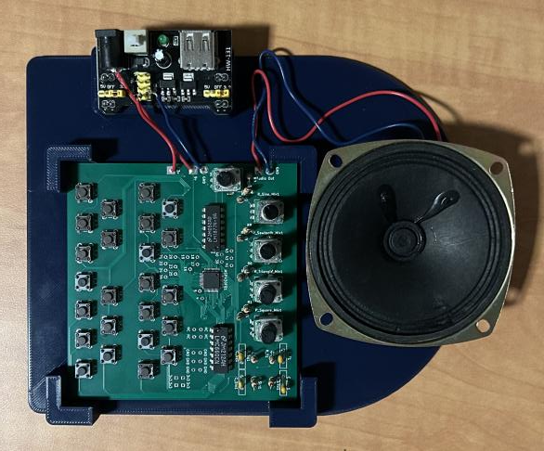
Results
Full PCBA
Power Supply Board
Mounted Speaker

Slide 12
Thank You!

Slide 14
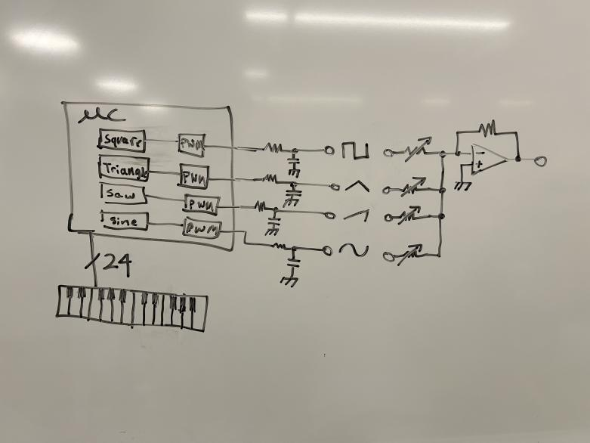
Block Diagram

Slide 15
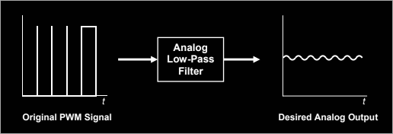
Digital Output

