Slide 1

CLOUD MIGRATION SUCCESS STORIES

Slide 2

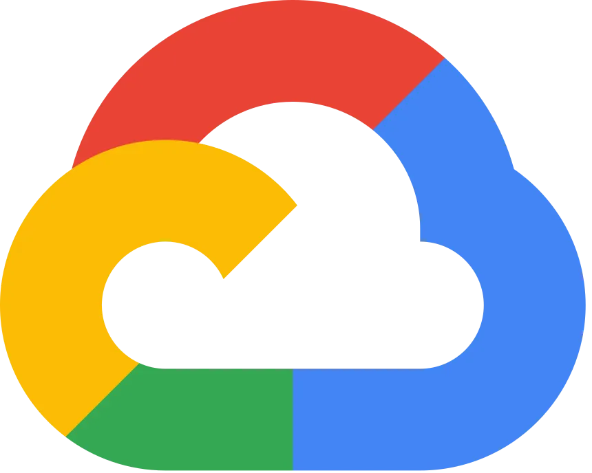
JB Hunt Summary (CSP Source)
Needed technology that could handle the workload of their growth
Moved environments (VMs, clusters, databases) to GCP multicloud in 35 days
Total services migrated:
  1,000 VMs
  90 Kubernetes clusters
  915 Kubernetes nodes
  27,000 pods
  500 databases
Original analysis predicted a 6 month migration
Strong planning led to agile and quick migration
Migration did not bring interruptions to their clients and lowered downtimes

Slide 3


Capital One (Non-CSP Source)
Background
Capital One sought to modernize its IT environment.
As a financial institution, it must follow stringent regulatory requirements and protect sensitive customer data.
The company decided to embrace a “cloud‐first” strategy to stay competitive and innovate faster.
Challenges
Legacy Systems: Capital One relied on older, monolithic applications that were costly to maintain and difficult to update frequently.
Security & Compliance: Operating in the highly regulated finance sector meant Capital One had to ensure strict data protection, governance, and compliance with regulations like PCI DSS (Payment Card Industry Data Security Standard).
Culture Shift: Migrating to the cloud wasn’t just a technology shift; it also required retraining teams, changing internal processes, and gaining executive buy‐in
Notes:
https://www.capitalone.com/software/blog/cloud-migration-journey/

Slide 4

Capital One (cont.)
Solution and Outcomes
Strategic Cloud Adoption: Capital One targeted specific applications and services that benefited most from cloud elasticity
Microservices & Containers: They refactored portions of their platform into containerized microservices, making their systems more modular and easier to update
Continuous Integration/Continuous Deployment (CI/CD): This streamlined development so Capital One could release new features and bug fixes more frequently
Automated Security Tools: Capital One leveraged cloud‐native security services to ensure compliance and reduce manual processes.
Conclusion
Capital One drastically reduced the time to deploy new features—improving customer experience—and cut long‐term infrastructure and maintenance costs.
With cloud’s flexible infrastructure, they also increased operational resilience and further automated governance to meet regulatory requirements.

Slide 5
Our Lessons Learned
Preparation is key
  J.B. Hunt had a detailed plan and simulated before migrating
Plan for everything to not go according to plan
  This is how J.B. Hunt succeeded extremely ahead of schedule.
Companies want smooth transitions to eliminate downtime
  Eliminating downtime directly relates to more profit.
There are many benefits of moving to the cloud that save companies money in the long term
  Some benefits are long-term reliability.

Slide 6
Sources
CSP Source:
https://cloud.google.com/customers/jb-hunt/
Non-CSP Source:
https://www.capitalone.com/software/blog/cloud-migration-journey/

