Slide 1
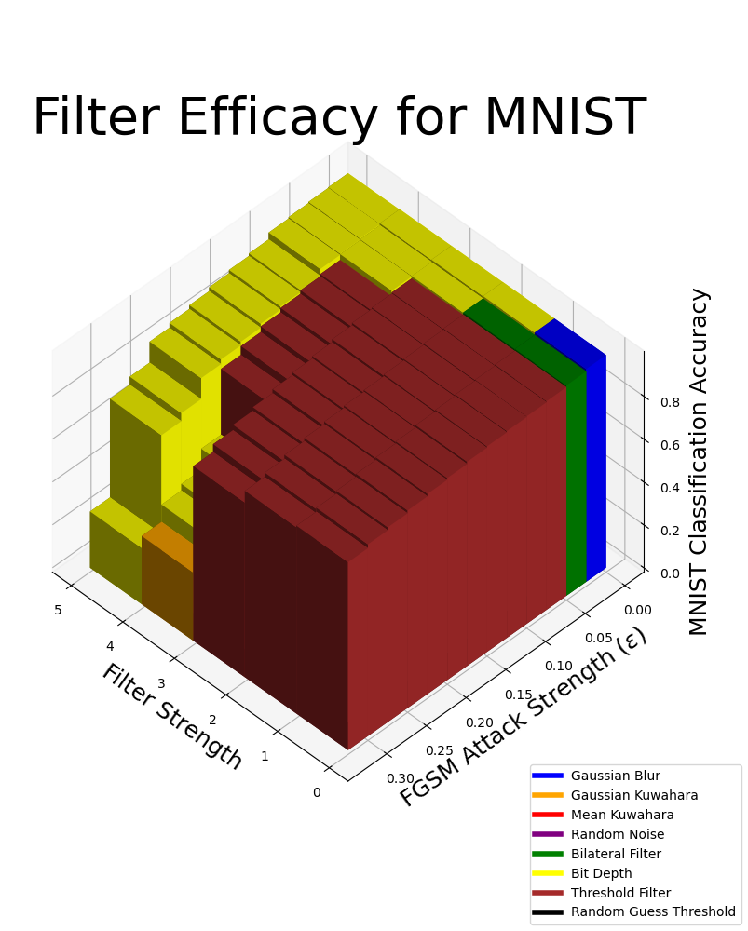
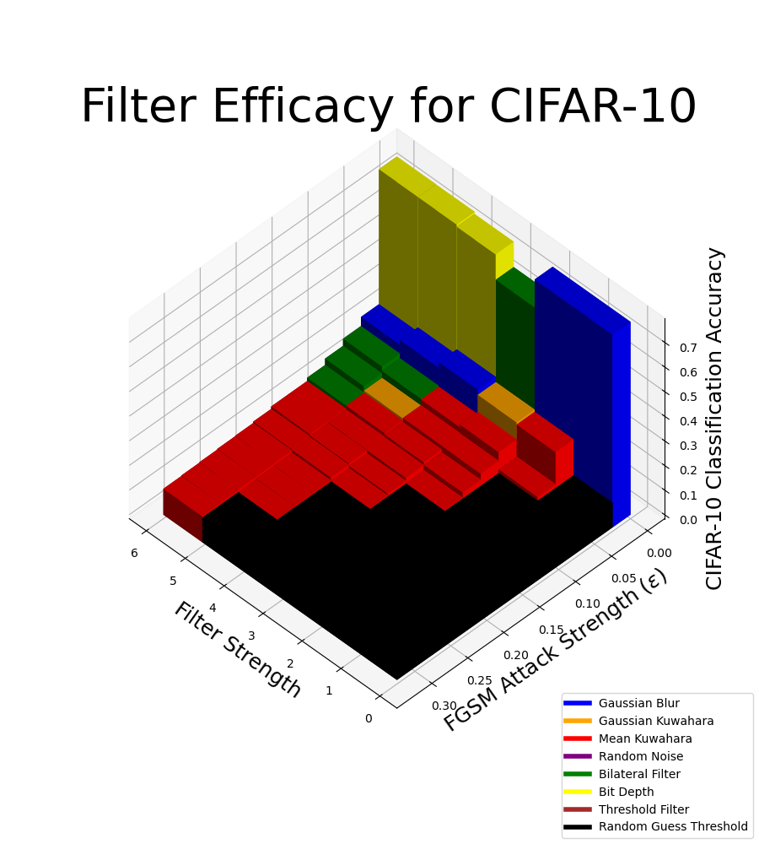
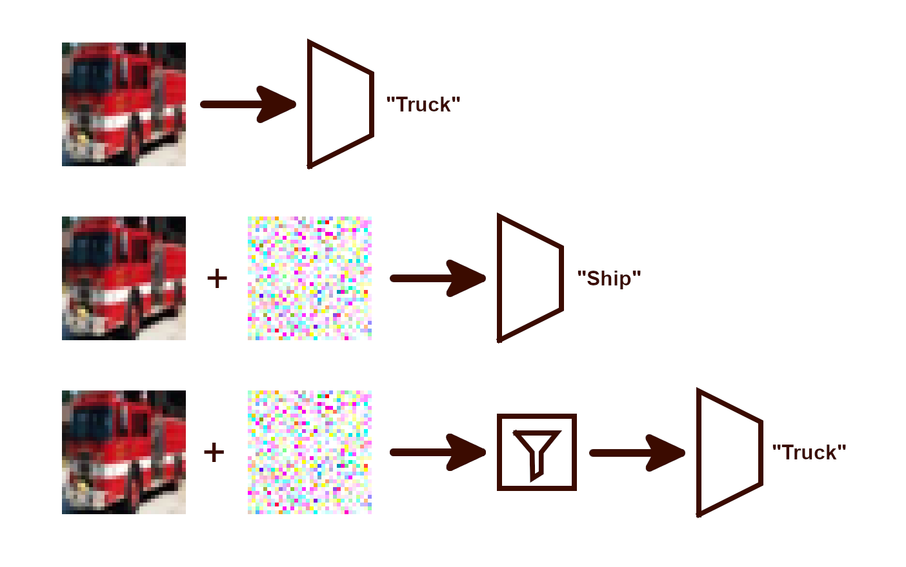
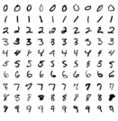
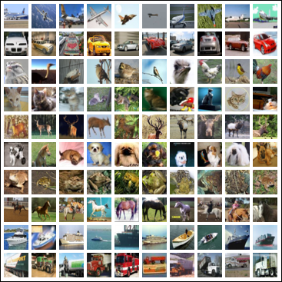

Enhancing Image Classifiers with Denoising Filters
Experimental Approach
Implement the FGSM attack
Test FGSM attack on pre-trained MNIST CNN classifier
Implement Gaussian Kuwahara filter between attack generation and model input stages
Create a standard interface to “plug and play” other filters, model, and attacks
Evaluate each filter individually with different attack strengths and on variations of the filter free parameter
  This free parameter is referred to generically as “strength”, although some filters have greater impacts at lower “strength”
Use the previously designed standard interface to test all filter alternatives on MNIST classifer
Train CIFAR-10 classifer
  Initial CNN could only achieve ~65%-70% accuracy on validation dataset
  DLA trained on CIFAR-10 seemed more promising
  VGG16 trained on CIFAR-10 for 40 epochs scored achieved over 80% accuracy on validation dataset
Use the previously designed standard interface to test all filter alternatives on VGG16 classifier trained on CIFAR-10
Compare which filters are most effective and how effective they are at defending MNIST and CIFAR-10 classifiers against FGSM
Alternative Filters
Gaussian Blur
Gaussian Kuwahara Filter
Mean Kuwahara Filter
Bilateral Filter
Random Noise
Threshold Filter
Bit-Depth Reduction
Alternative Datasets
MNIST – High contrast, greyscale, 28x28
CIFAR-10 – Med. contrast, RGB, 32x32
Alternative Attacks
Fast Gradient Sign Method (FGSM)
Carlini and Wagner (Planned)
Health & Safety Considerations
Self-driving systems must respond rapidly and accurately to ensure passenger safety
A lightweight filtering approach was chosen over an ML-based defense to reduce the time between perception and classification
Social Considerations
All software and data used is free and open source (FOSS)
Ensures full and equal access to all who wish to recreate the results or defend their own models
Environmental Considerations
Using image processing eliminates the computationally expenive training process found in ML-based defenses
While untested, denoising filters may also be more energy-efficient than ML-based defenses during use
Economic Considerations
Vulnerable models may be used to facilitate cybercrime or cause real-world financial harm
Being proactive prevents huge future costs
Experimental Results
Evaluation & Validation
Conclusions
MNIST filtering maintains accuracy at higher values of ε
CIFAR-10 is more strongly affected by FGSM
AIDAN SHARPE
Advisor: Dr. Robi Polikar
Rowan University,
Henry M. Rowan College of Engineering,
Glassboro, NJ 08028
Problem Statement
Neural networks are vulnerable to adversarial attacks [1], [2]. This project investigates the efficacy of various image processing techniques at improving the robustness of image classifier models.
Requirements
Show that image preprocessing filters are an effective defense against common adversarial attacks
Compare the efficacy of different filters at different strengths
Show the transferability of image preprocessing across different datasets and classifier architectures
Constraints & Tradeoffs
Limited computational resources
  Restricted the resolution of datasets used
  Limited model complexity (parameters, epochs, etc.)
Engineering Standards
ECMA 404 [3]
IEEE 3129-2023 [4
References
MNIST Excerpt
CIFAR-10 Excerpt
Notes:
SEMESTER 2 DRAFT
Elise reworked main goal, intro & motivation, constraints, impact factors, and standards and moved future work to bottom

