Slide 1
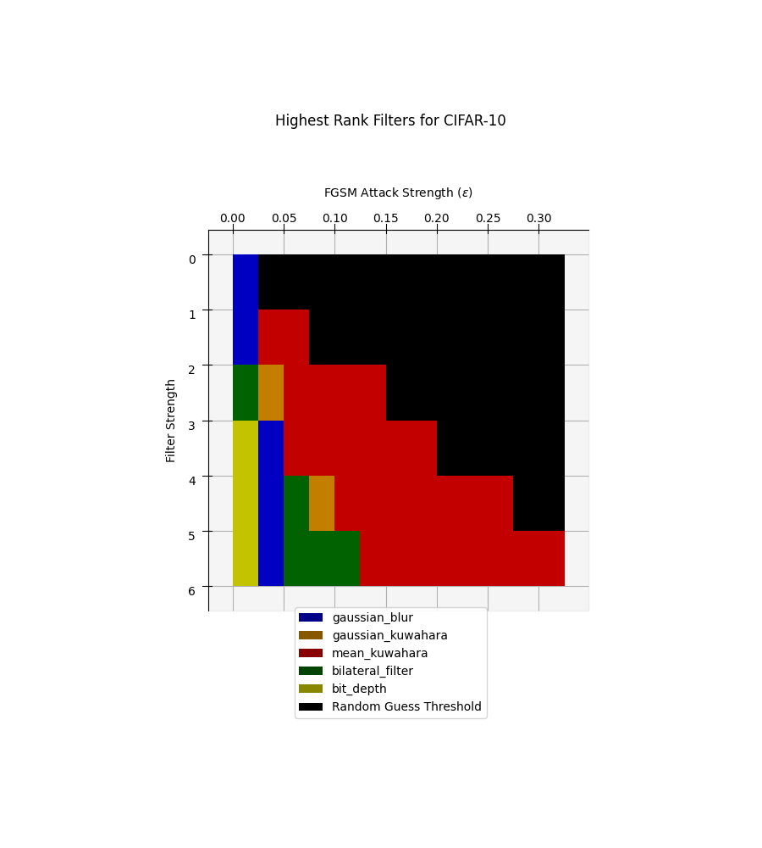
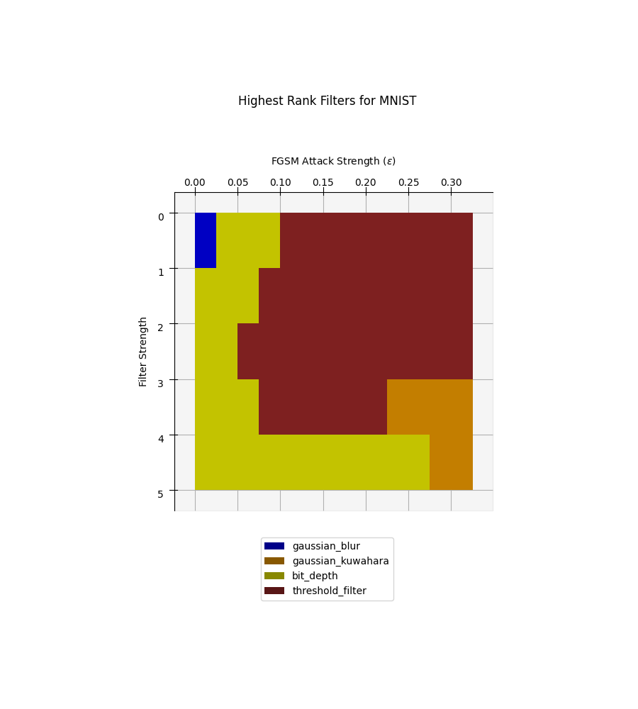
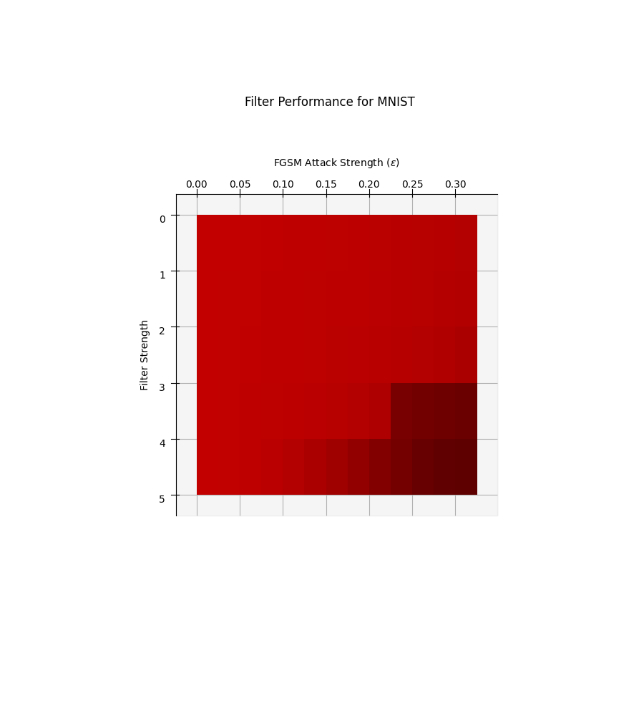
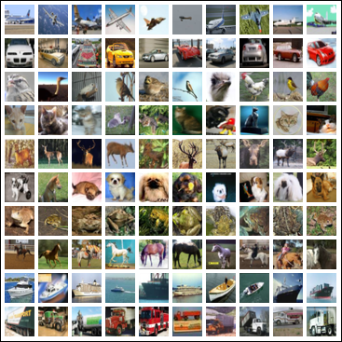
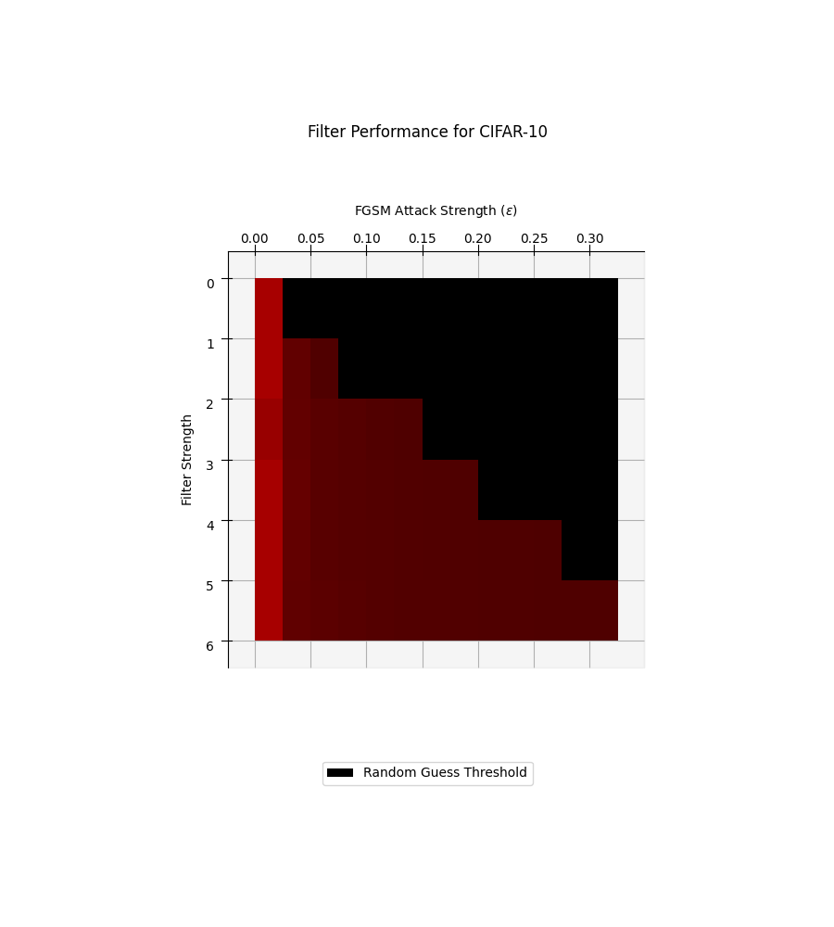
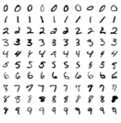

Enhancing Image Classifiers with Denoising Filters
Health and Safety Considerations
In self-driving systems, images must be correctly processed and reacted to
Vulnerable systems put passenger saftey in the hands of the attacker
Social Considerations
All software and data used is free and open source (FOSS). This ensures full and equal access to all who wish to recreate the results or defend their own models.
Environmental Considerations
Running a denoising filter as opposed to an auto-encoder does not require a computationally (energy) intense training process. Denoising filters may also be more energy-efficient during use, although this is an untested hypothesis.
Economic Considerations
Cybercrime is an increasingly lucritive business for attackers. By building more robust image classification systems, anything from facial recognition to
Realistic Constraints
Image dataset resolution
  Dataset size vs. object clarity
Applicable Engineering Standards
ECMA 404
IEEE 3129-2023
AIDAN SHARPE
Advisor: Dr. Robi Polikar
Rowan University,
Henry M. Rowan College of Engineering,
Glassboro, NJ 08028
Problem Statement
Compare the impact of an array of denoising filters at boosting the resilience of image classifier against adversarial examples
Approach
Train (at least) two different image classifier models trained on two different types of image datasets with the same number of classes
Attack each model with (at least) two different gradient-based attacks with a range of attack strengths
Compare the effectiveness of several denoising filters with a range of denoising strengths at maintaining the accuracy of the model
Alternative Filters
Gaussian Blur
Gaussian Kuwahara Filter
Mean Kuwahara Filter
Bilateral Filter
Random Noise
Threshold Filter
Bit-Depth Reduction
Alternative Datasets
MNIST – High constrast, greyscale, 28x28
CIFAR-10 – Low contrast, RGB, 32x32
Alternative Attacks
Fast Signed Gradient Method (FGSM)
Carlini and Wagner
CIFAR-10 Excerpt
MNIST Excerpt
Notes:
SEMESTER 2 DRAFT
Elise reworked main goal, intro & motivation, constraints, impact factors, and standards and moved future work to bottom

