Slide 1
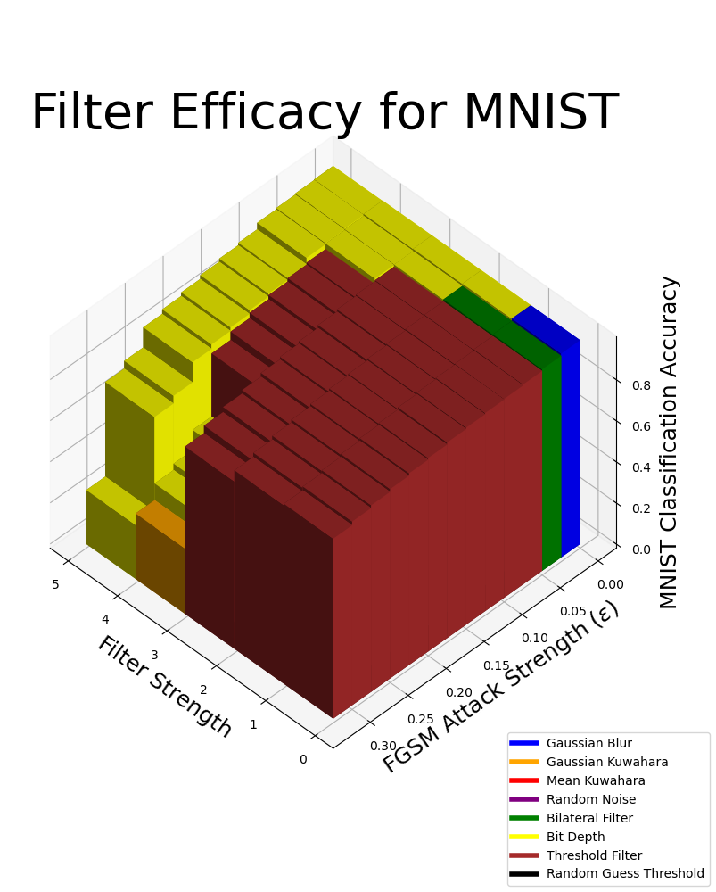
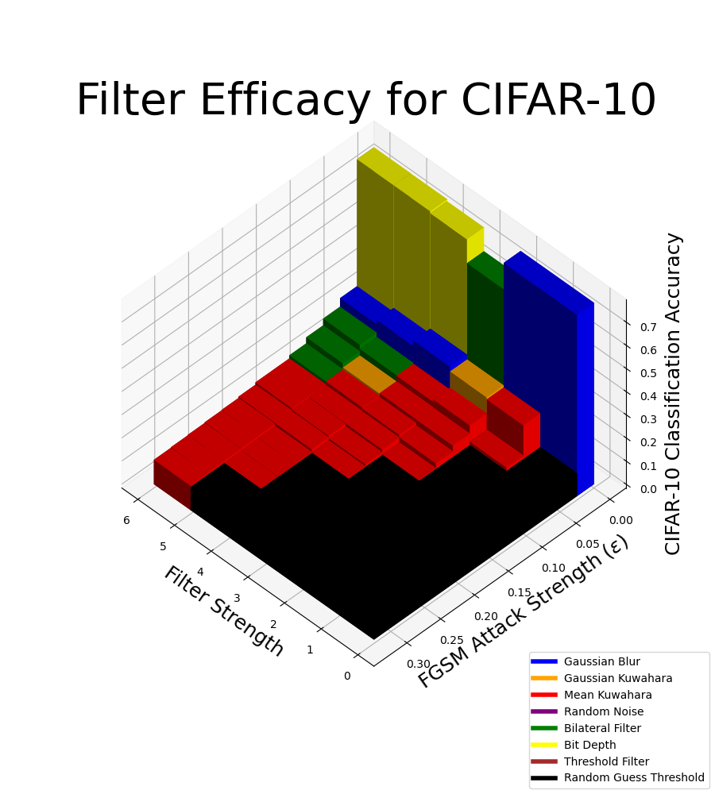
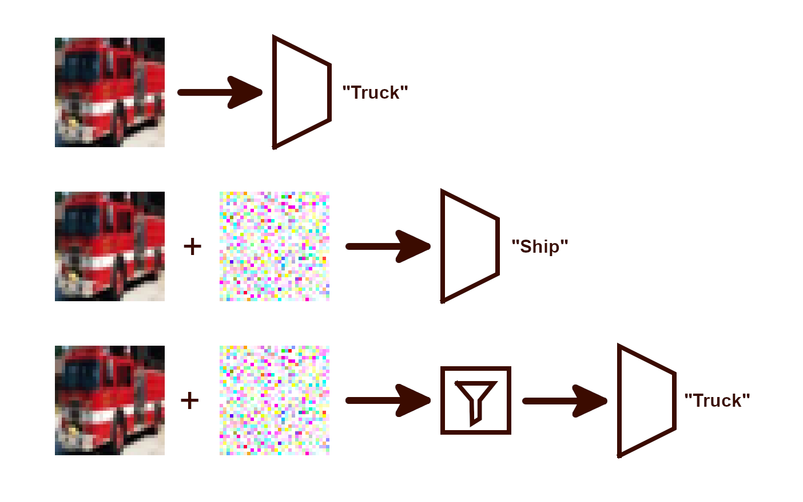
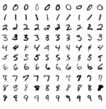
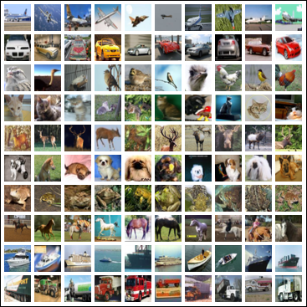

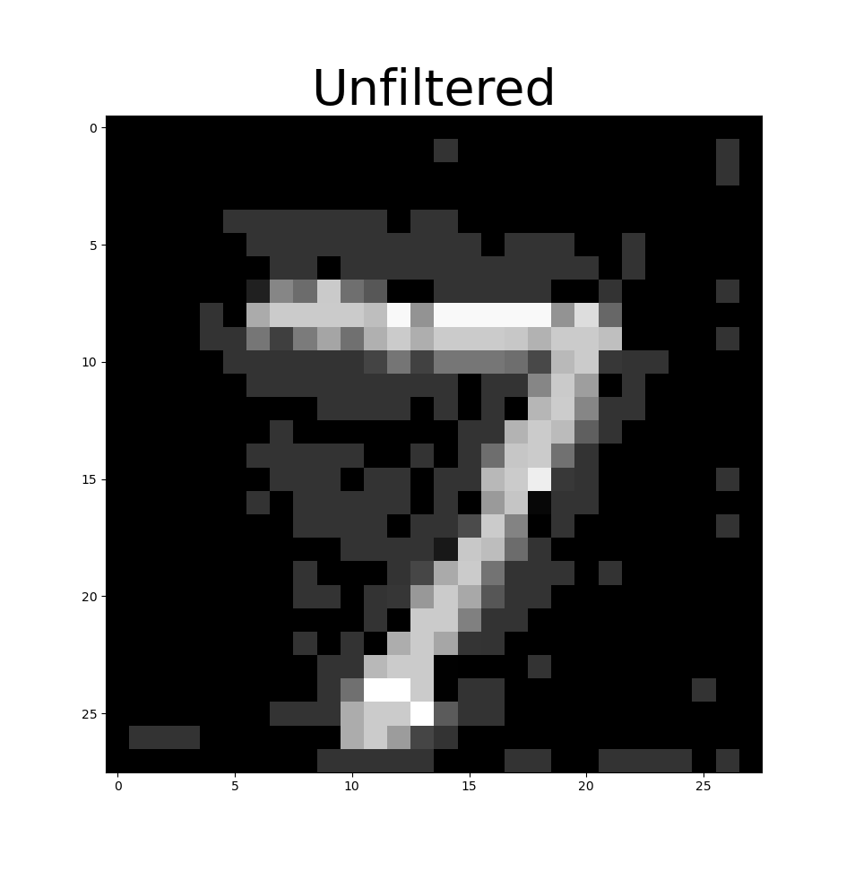
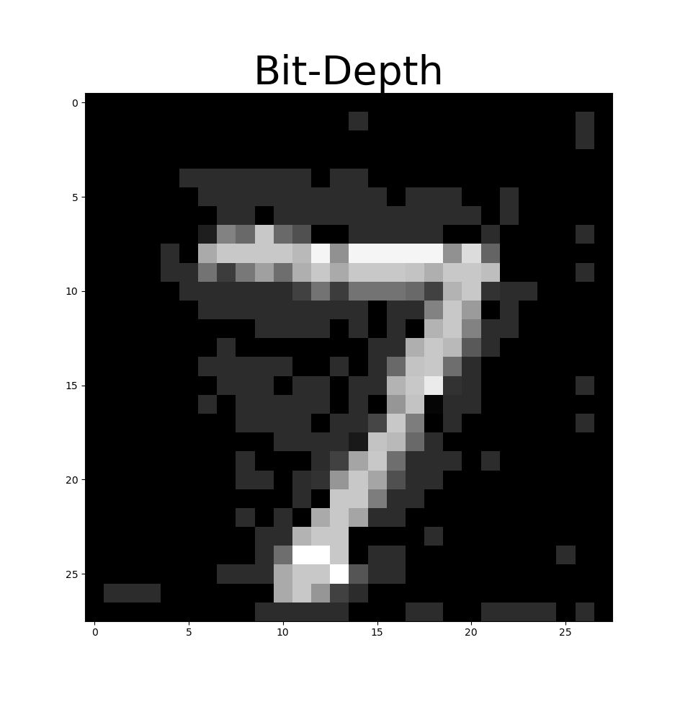
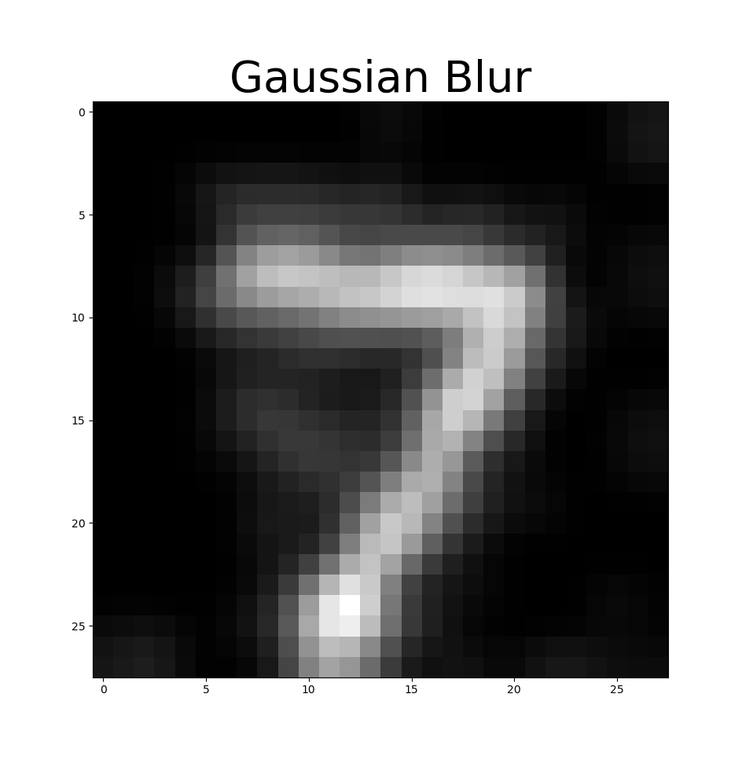
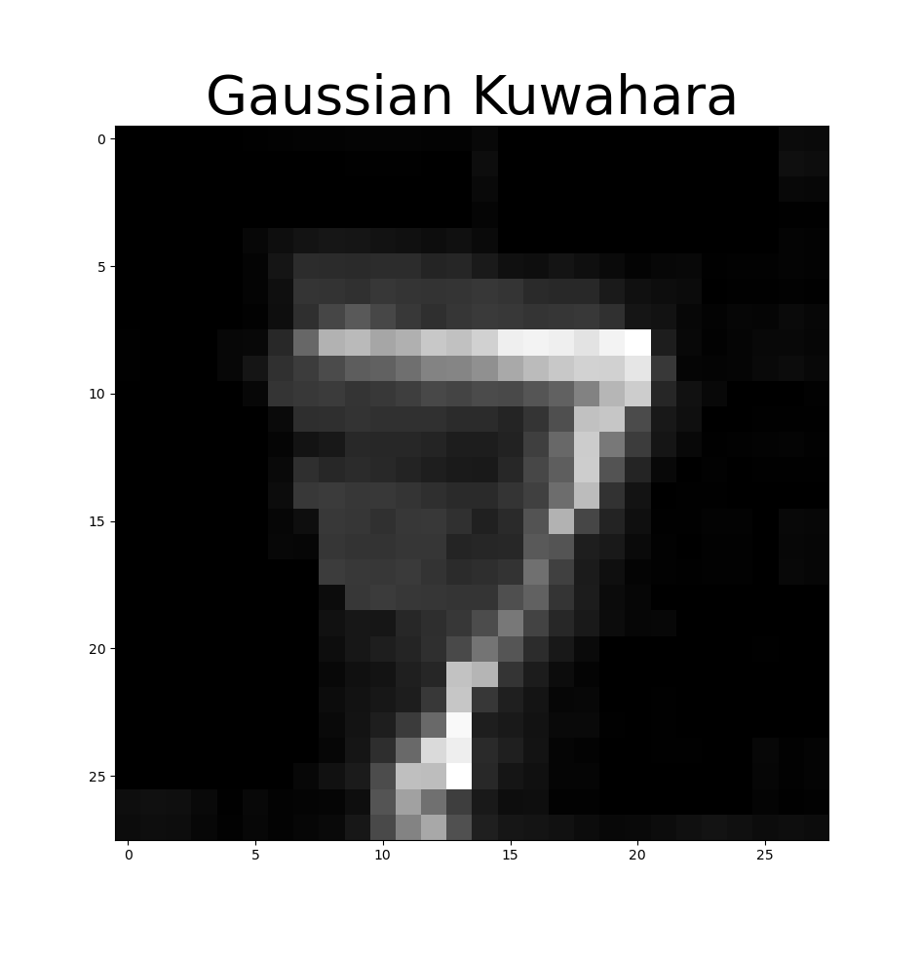
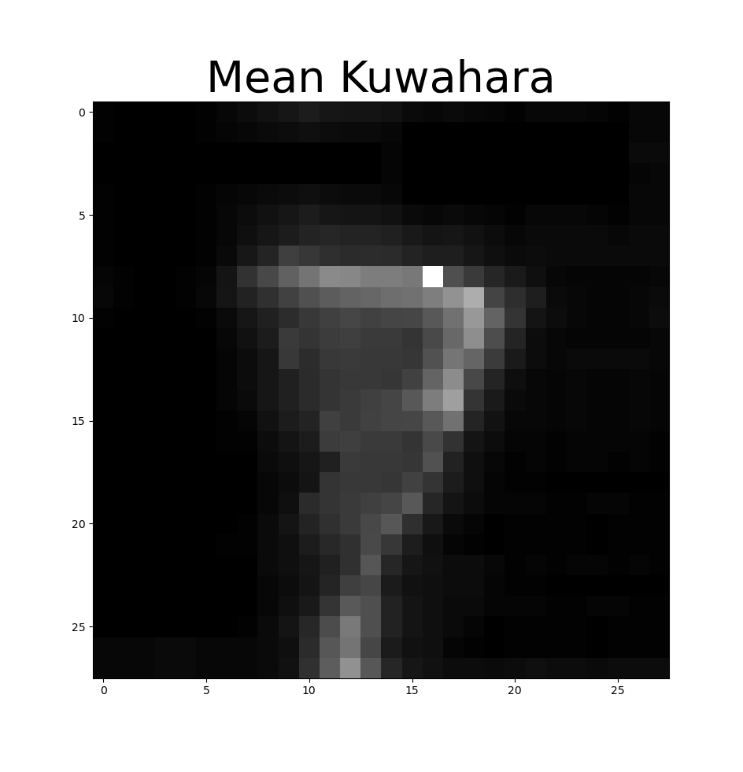
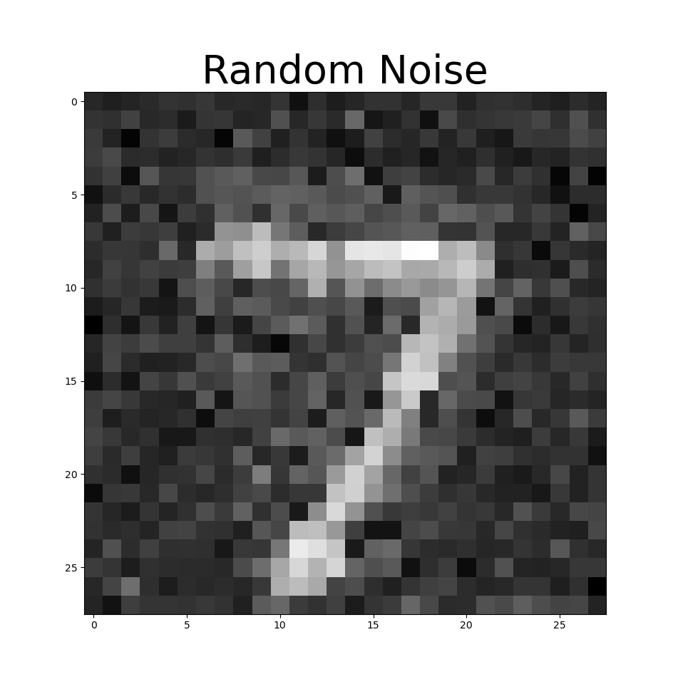
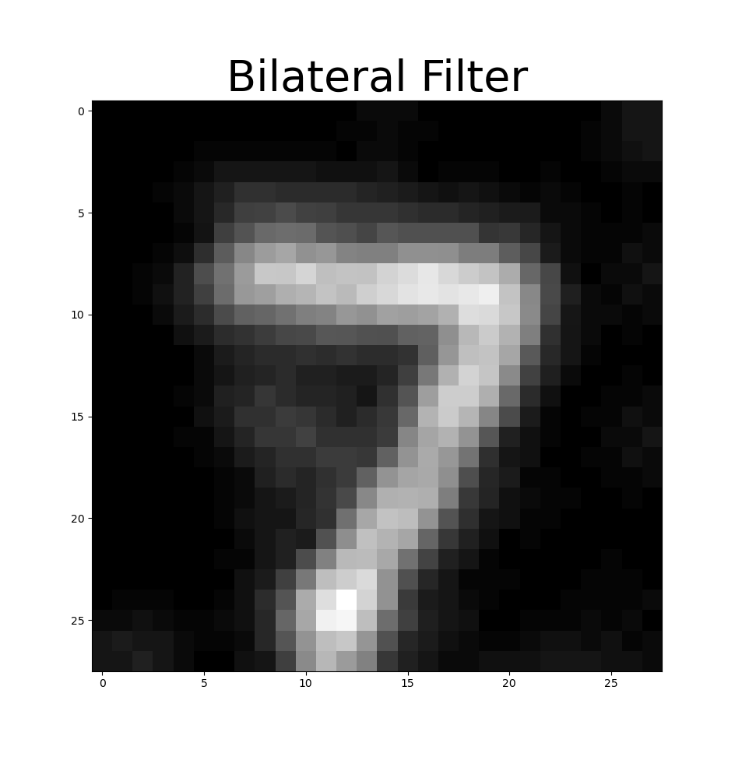
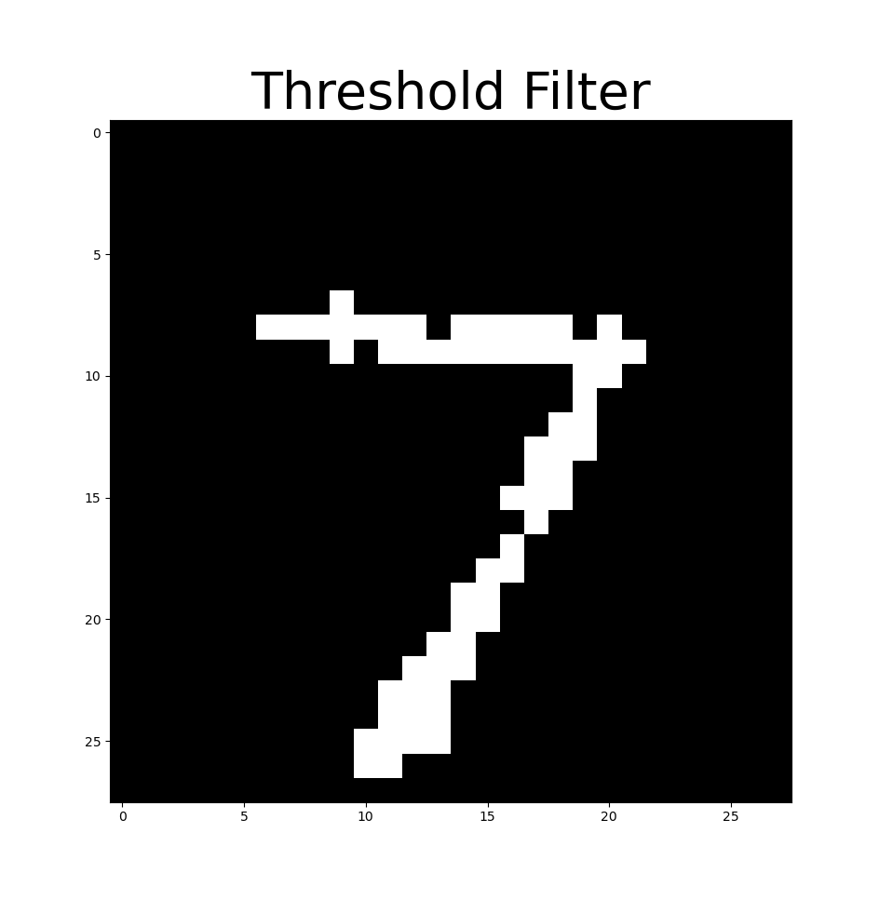



Enhancing Image Classifiers with Denoising Filters
Experimental Approach
Implement the FGSM attack [5]
Test FGSM attack on pre-trained MNIST CNN classifier
Implement Gaussian Kuwahara filter between attack generation and model input stages
Create a standard interface to “plug and play” other filters, model, and attacks
Evaluate each filter individually with different attack strengths and on variations of the filter free parameter
  This free parameter is referred to generically as “strength”, although some filters have greater impacts at lower “strength”
Enable saving output data in JSON format [3]
Use the previously designed standard interface to test all filter alternatives on MNIST classifier
Train CIFAR-10 classifier
  Initial CNN could only achieve ~65%-70% accuracy on validation dataset
  DLA trained on CIFAR-10 was more promising [6]
  VGG16 trained on CIFAR-10 for 40 epochs scored over 80% accuracy on validation dataset [7]
Use the previously designed standard interface to test all filter alternatives on VGG16 classifier trained on CIFAR-10
Compare which filters are most effective and how effective they are at defending MNIST and CIFAR-10 classifiers against FGSM
Create a program that reads the saved JSON data and generates custom views of the results
Alternative Filters
Gaussian Blur
Gaussian Kuwahara Filter
Mean Kuwahara Filter
Bilateral Filter
Random Noise
Threshold Filter
Bit-Depth Reduction
Alternative Datasets
MNIST – High contrast, greyscale, 28x28
CIFAR-10 – Med. contrast, RGB, 32x32
Alternative Attacks
Fast Gradient Sign Method (FGSM) [5]
Carlini and Wagner (Planned) [2]
Health & Safety Considerations
Self-driving systems must respond rapidly and accurately to ensure passenger safety
A lightweight filtering approach was chosen over an ML-based defense to reduce the time between perception and classification
Social Considerations
All software and data used is free and open source (FOSS)
Ensures full and equal access to all who wish to recreate the results or defend their own models
Environmental Considerations
Using image processing eliminates the computationally expenive training process found in ML-based defenses
While untested, denoising filters may also be more energy-efficient than ML-based defenses during use
Economic Considerations
Costs are minimized by prioritizing lightweight, power-saving algorithms
Less computationally intense filters with similar results should rank higher
Experimental Results
Evaluation Criteria
The accuracy of a classifier model is given by:
The random guessing threshold is the expected accuracy if a class was guessed at random
A weak learning algorithm produces a prediction rule that performs just slightly better than random guessing [8]
A filter is deemed minimally effective if the classifier performs at least as well as a weak learning algorithm
A filter is deemed ideally effective if the accuracy of the classifier does not change with the strength of attack
Conclusions
MNIST filtering maintains accuracy at higher ε
CIFAR-10 is more strongly affected by FGSM
The threshold filter on MNIST is almost ideally effective
The most effective filters CIFAR-10 are only minimally effective
Future Work
Implement and test Carlini and Wagner attack [2]
Implement and test ImageNet dataset
Implement more filters
  Median blur
  JPEG compression
  Anisotropic diffusion
Test the power use of an image processing defense against an ML-based defense
Standardize the meaning of strength
  SNR-based definition [9]
  Lp norm-based definition
AIDAN SHARPE
Advisor: Dr. Robi Polikar
Rowan University,
Henry M. Rowan College of Engineering,
Glassboro, NJ 08028
Problem Statement
Neural networks are vulnerable to adversarial attacks [1], [2]. This project investigates the efficacy of various image processing techniques at improving the robustness of image classifier models.
Requirements
Show that image preprocessing filters are an effective defense against common adversarial attacks
Compare the efficacy of different filters at different strengths
Show the transferability of image preprocessing across different datasets and classifier architectures
Constraints
Limited computational resources
  Restricted the resolution of datasets used
  Limited model complexity (parameters, epochs, etc.)
Engineering Standards
ECMA 404 [3]
IEEE 3129-2023 [4]
Block overview of adversarial attacks and filtering pipeline
MNIST Excerpt
CIFAR-10 Excerpt
Effect of filtering a sample from MNIST attacked with FGSM at ε=0.2
References
Source Code
Notes:
SEMESTER 2 DRAFT
Elise reworked main goal, intro & motivation, constraints, impact factors, and standards and moved future work to bottom

