Slide 1


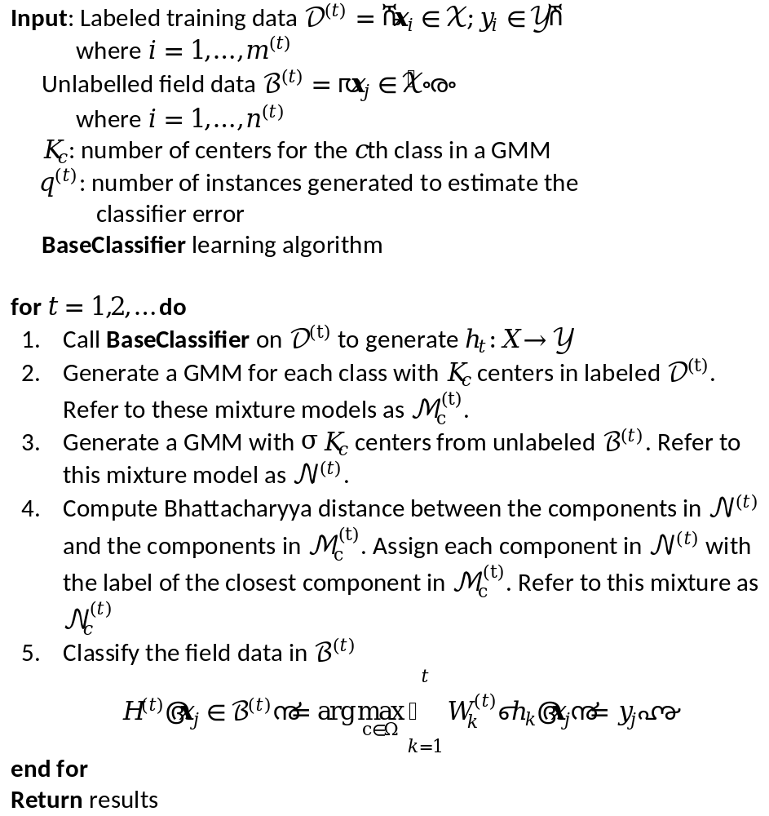
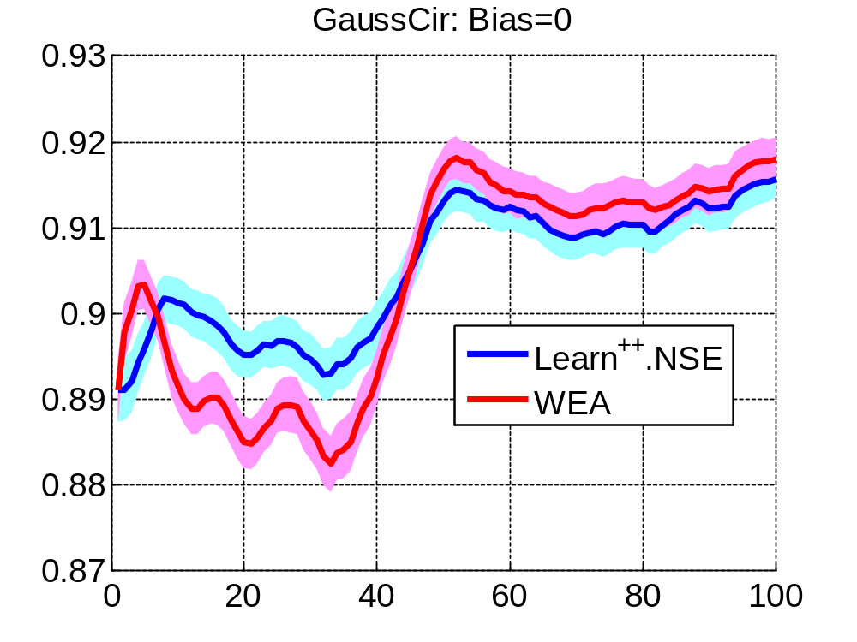
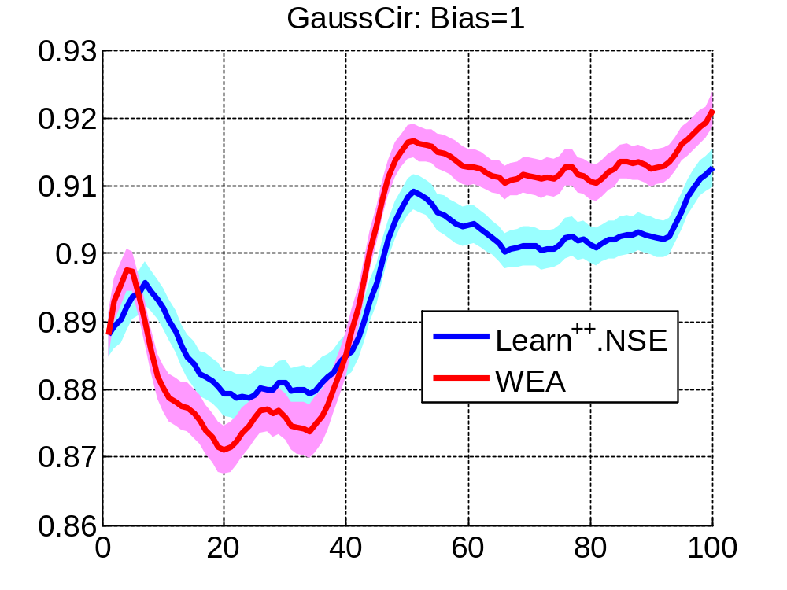
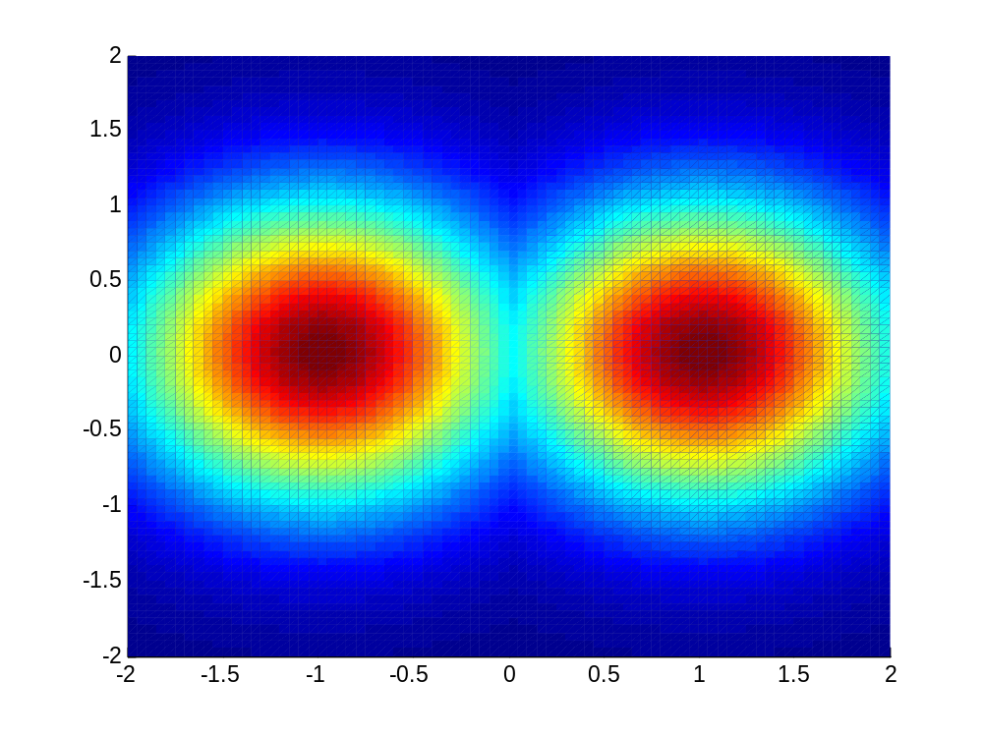
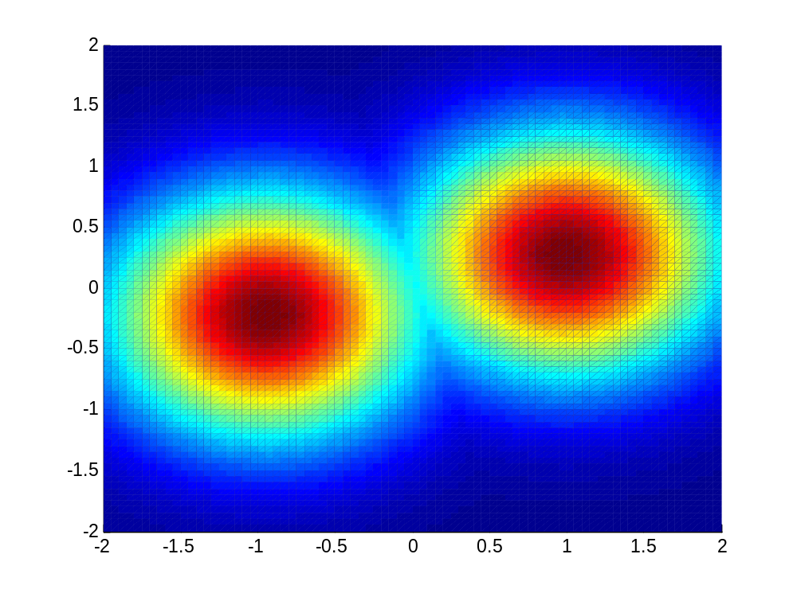
Defending Against Adversarial
Examples with Preprocessing Filters
Aidan Sharpe
Project Manager: Dr. Robi Polikar
Department of Electrical & Computer Engineering; Rowan University, Glassboro, NJ 08028
sharpe23@students.rowan.edu polikar@rowan.edu
Problem Statement & Significance
Approach / Methodology
Experimental Setup
Level 1 bullet item – Main problem statement. What is the specific problem to you are trying to solve? What is the gap in the state of knowledge that you are trying to fill? What is the goal of the project?
Level 1 bullet item 2 – Perhaps some motivation on why this is a problem that is worth solving
  Level 2 bullet item
    Level 3 text (smallest text no smaller than font size 24)
    More Level 3 text
    There should be no smaller Level 4 text
  More Level 2 text
Significance – What is the significance / impact of solving this problem
  Reason 1
    Additional context
  Applications
Experimental Setup
  …..
Evaluation and Validation
  …..
Datasets & Parameter Selection
  Circular Gaussian Drift: two class problem consisting two Gaussian components drifting in a circular pattern
  Triangular Gaussian Drift: three class problem consisting three Gaussian components drifting in a triangular pattern
Results
Findings
  Findings 1
  Findings 2
Background / Prior Methods
(a)
(b)
Requirements / Deliverables
Standards & Constraints
Algorithm 1. Our Algorithm
Figure 2. Raw classification accuracy on the GaussCir dataset. The level of bias between the labeled and unlabeled data varies as follows: (a) zero bias, (b) 1 time stamp.
Training distribution @ t=t₀
Testing distribution @ t=t₀
Applicable engineering standards
  IEEE 3129-2023
  ECMA 404
  …
Real-world constraints (must be non trivial)
  Constraint 1 and why is it a constraint?
  Constraint 2 and why is it a constraint?
  …
Conclusion & Future Work
Conclusions
Our approach works very well
  Limitations
    We made these assumptions that may not always hold true…
  Future Work
    We will address this and that in our next work
Figure 1. Figure Caption
Design Impact Statement
Alternative Approaches/ Optimization
Impact on public health, welfare, safety
In order to ensure safety, we chose / implemented / ….
  Impact on the environment
    …
  Impact on economic factors
    …
  Impact on social, cultural, global factors
    …
Alternative approach 1
Advantages / disadvantages; why was it not used
……
Alternative approach 2
Advantages / disadvantages; why was it not used
……..
Acknowledgements
This work was supported by…. (if applicable)
References
You may list references or use a QR code to point to a list of references
Poster Template Design by Robi Polikar © 2018-2024

