Slide 1
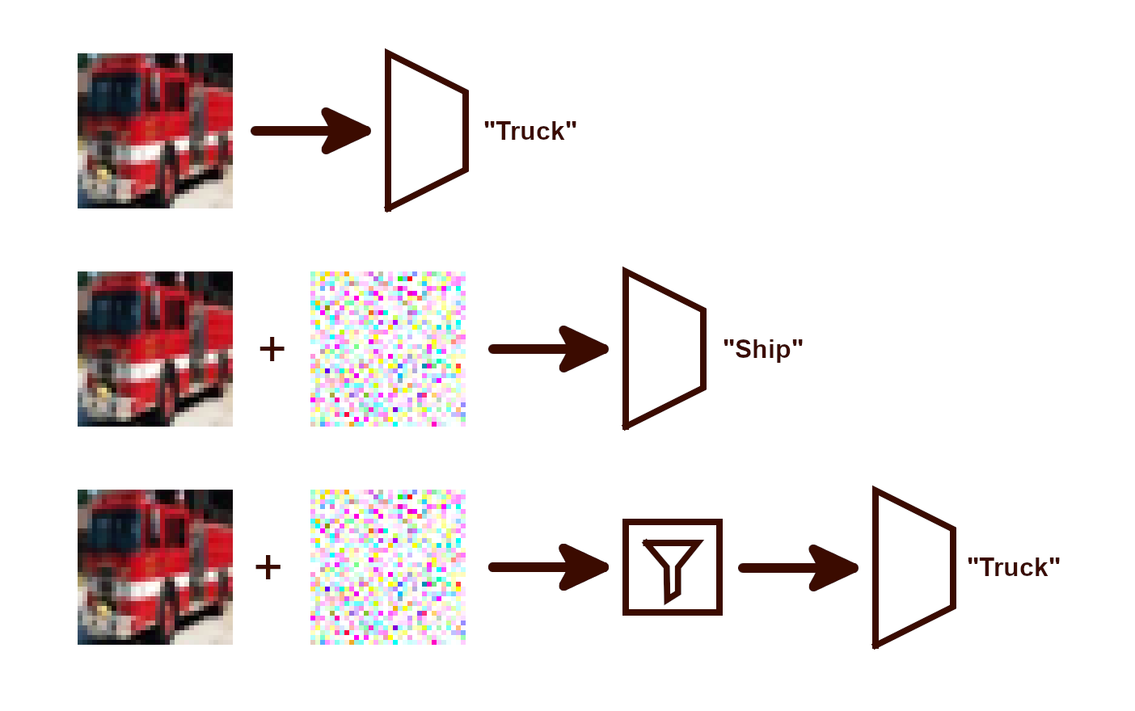
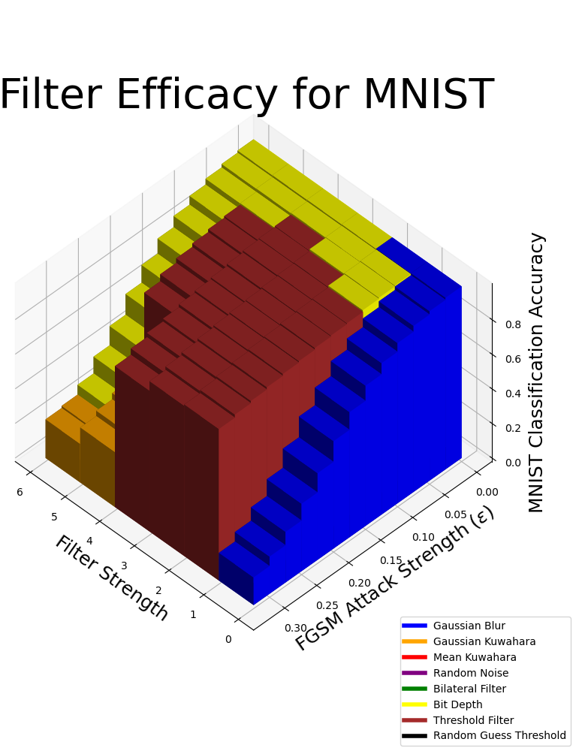
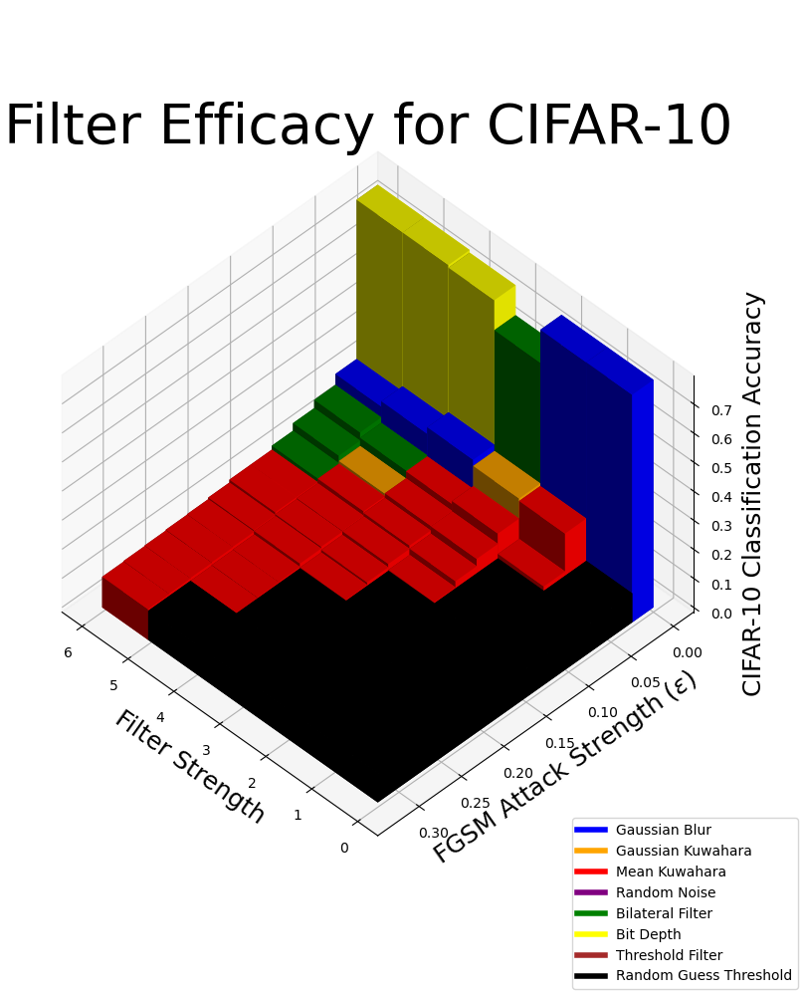
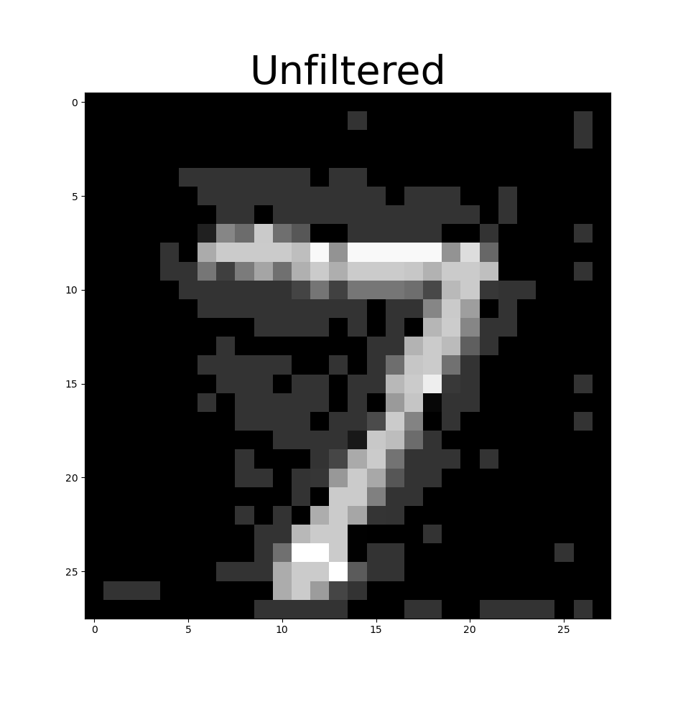
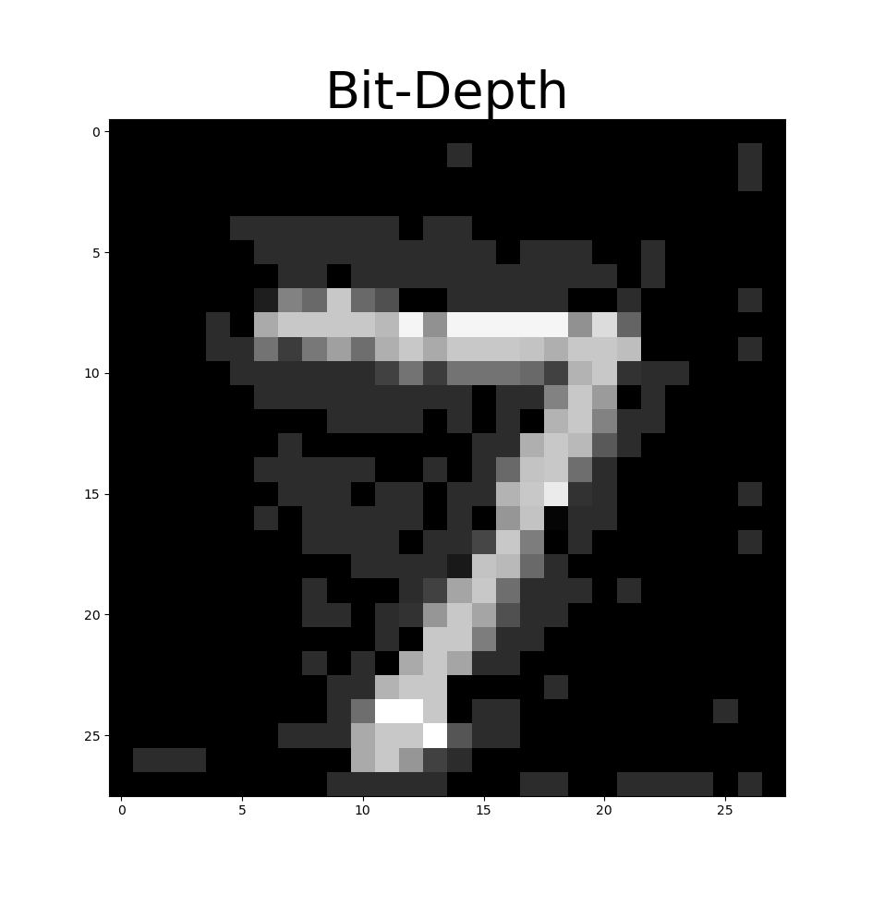
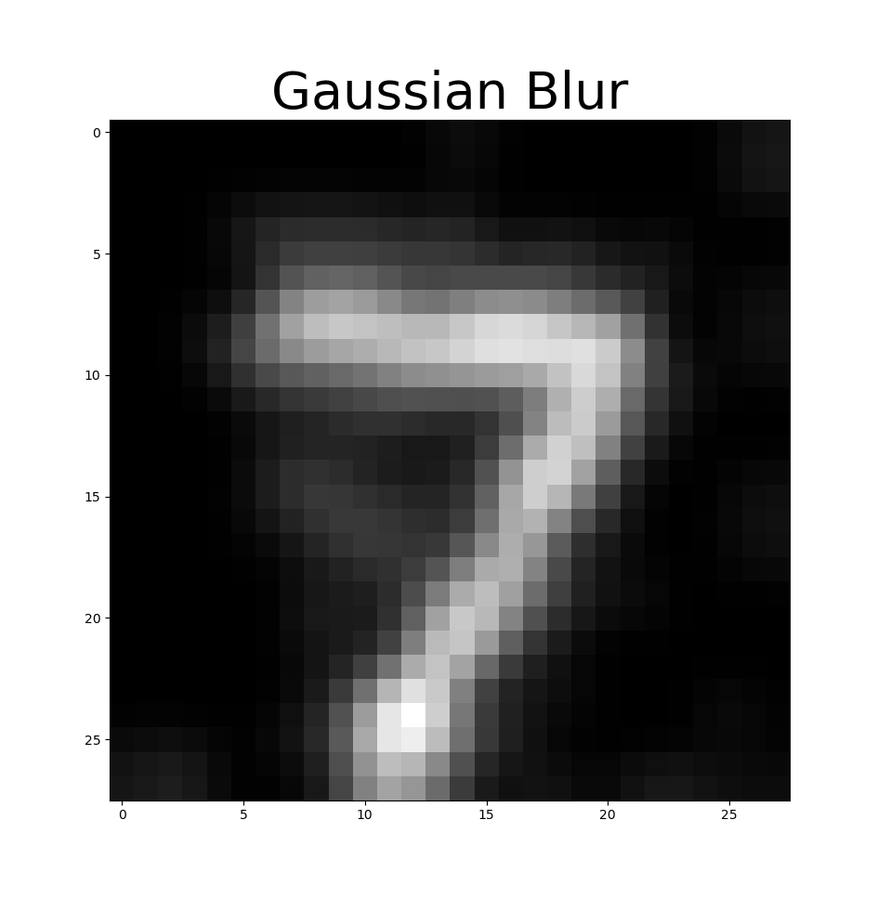
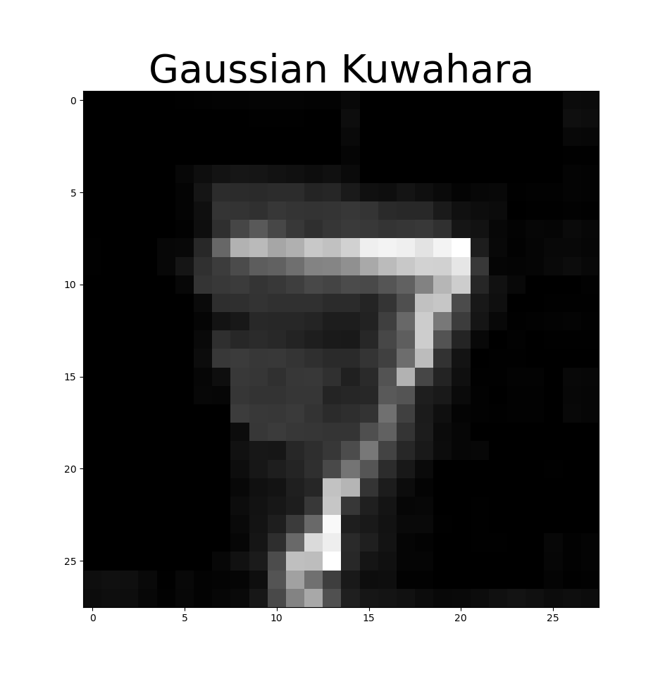
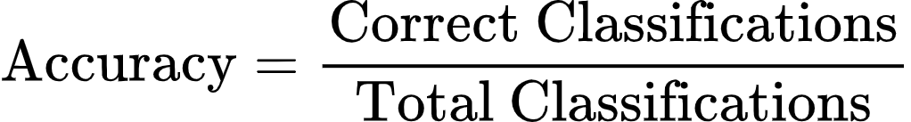
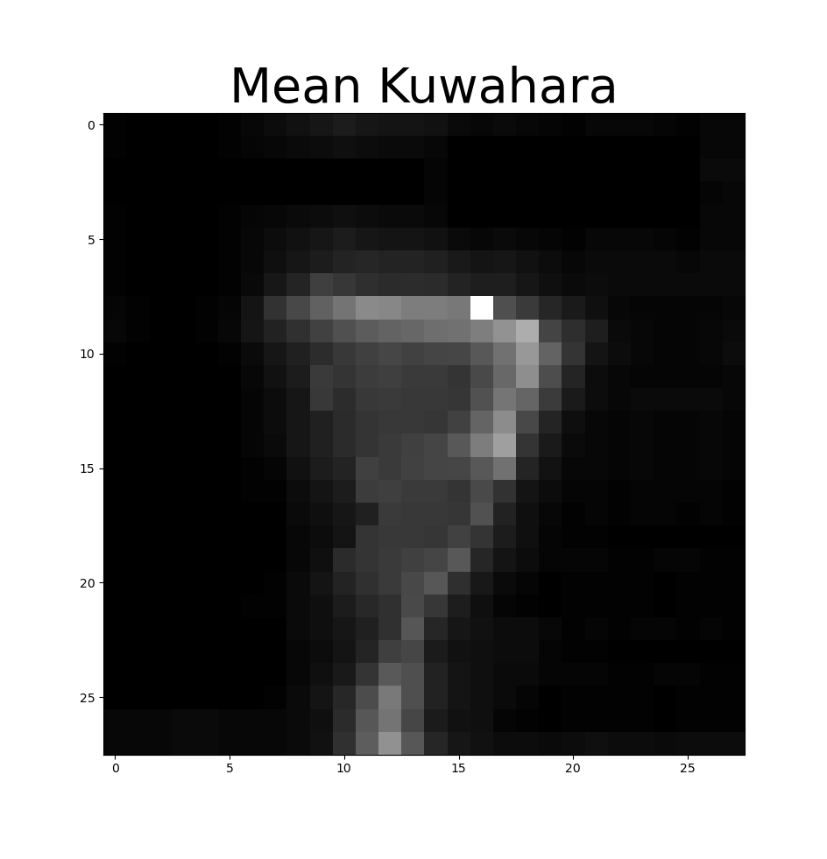
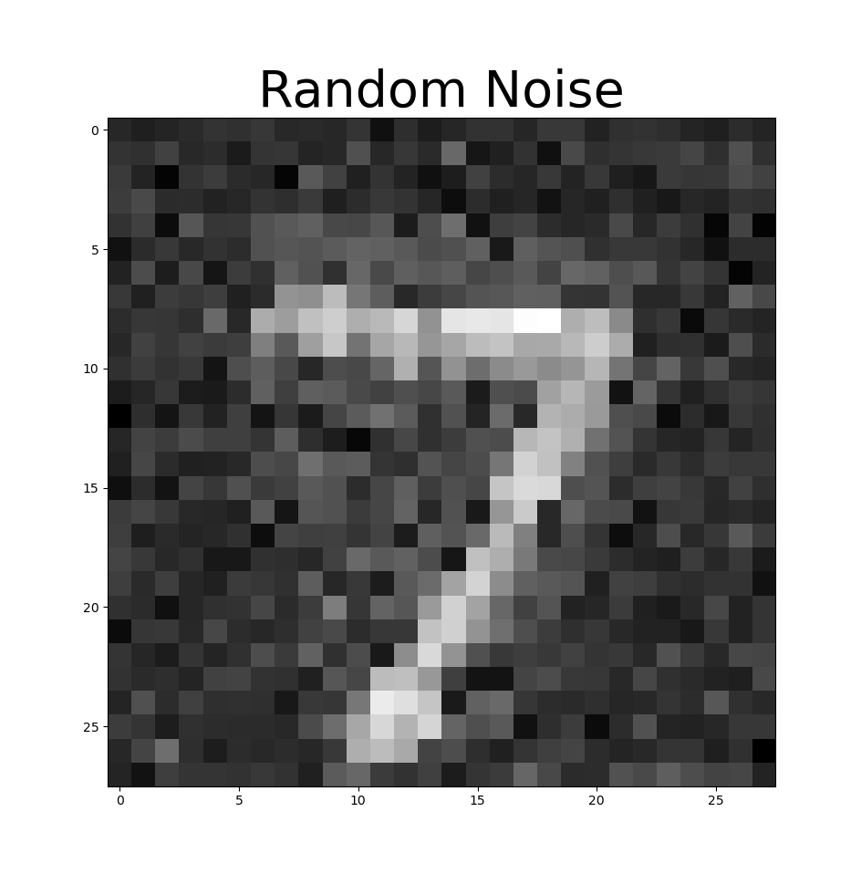
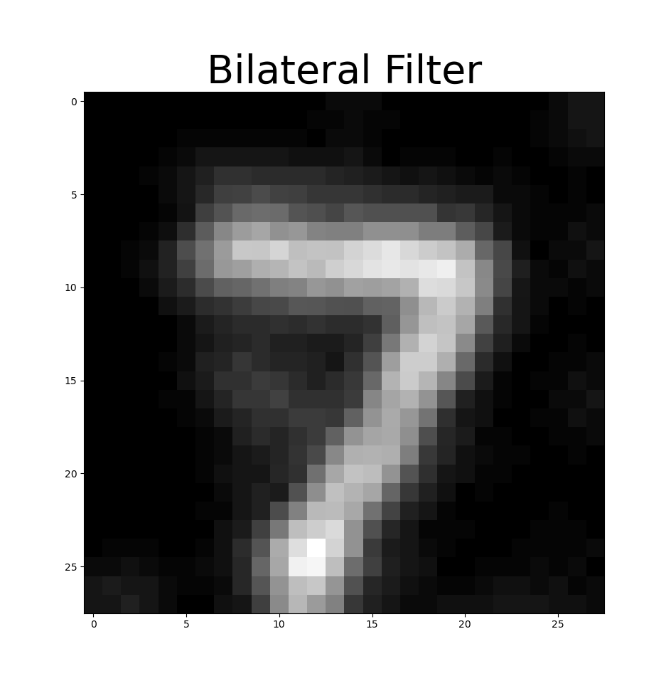
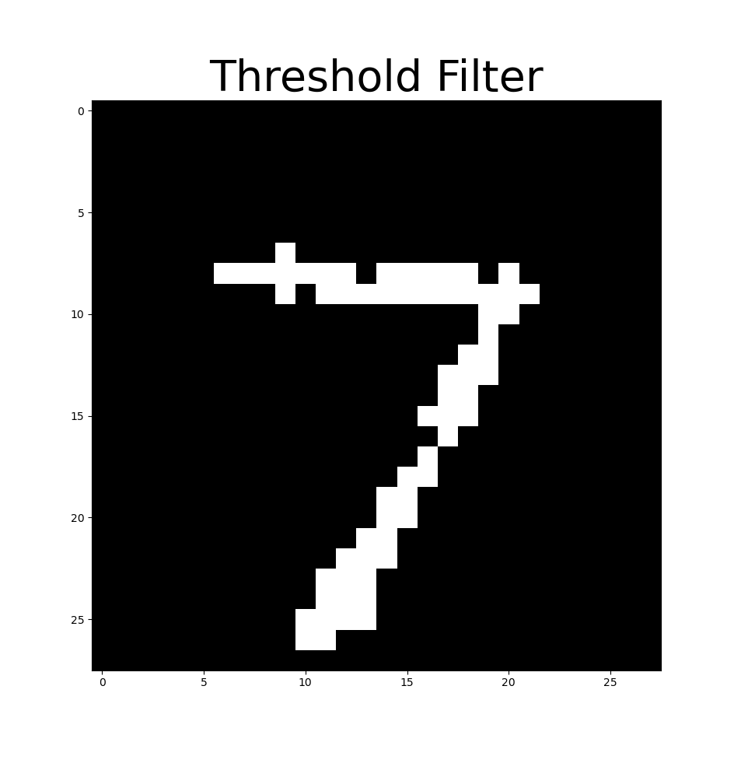
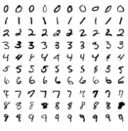
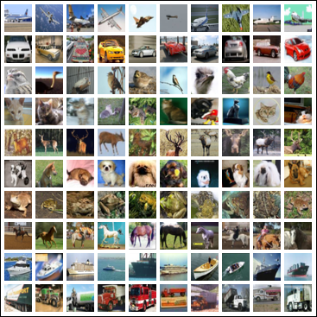



Enhancing Image Classifiers with Denoising Filters
Experimental Approach
Implement the FGSM attack [5]
Test FGSM attack on pre-trained MNIST classifier
Implement Gaussian Kuwahara filter as a defense
Create a standard “plug and play” interface to enable drop-in filters, model, and attacks
Evaluate each filter on different attack strengths with different values of the filter’s free parameter
  This free parameter is referred to generically as “strength”, although some filters have a greater impact on images at lower “strength”
Enable saving results in JSON format [3]
Train CIFAR-10 classifier
  Initial CNN could only achieve ~65%-70% accuracy on validation dataset
  DLA trained on CIFAR-10 was more promising [6]
  VGG16 trained on CIFAR-10 for 40 epochs scored over 80% accuracy on validation dataset [7]
Use the standard interface to test all filter alternatives on both MNIST and CIFAR-10
Tested Datasets
MNIST – High contrast, greyscale, 28x28
CIFAR-10 – Medium contrast, RGB, 32x32
Tested Attacks
Fast Gradient Sign Method (FGSM) [5]
Carlini and Wagner (Planned) [2]
Alternative Filters
Gaussian Blur
  Blurs edges and smooth areas
  Removes high frequency information (lowpass)
Gaussian Kuwahara Filter
  Blurs smooth area, but preserves edges
  Has an oil painting-like effect
Mean Kuwahara Filter
  Similar effect as Gaussian Kuwahara
  Slightly different way of calculating pixel values
Bilateral Filter
  Edge-preserving smoothing filter
Random Noise
  May outweigh effects of adversarial noise
Threshold Filter
  Removes all low-amplitude information
Bit-Depth Reduction
  Acts like multiple thresholds to multiple values
Health & Safety Considerations
Self-driving systems must respond rapidly and accurately to ensure passenger safety
A lightweight filtering approach was chosen over an ML-based defense to reduce the time between perception and classification
Social Considerations
All software & data is free and open source (FOSS)
Ensures full and equal access to all who wish to recreate the results or defend their own models
Environmental Considerations
Using image processing eliminates the computationally expenive training process found in ML-based defenses
While untested, denoising filters may also be more energy-efficient than ML-based defenses during use
Economic Considerations
Costs are minimized by prioritizing lightweight, power-saving algorithms
Less computationally intense filters with similar results should rank higher
Experimental Results
Evaluation Criteria
The accuracy of a classifier model is given by:
The random guessing threshold is the expected accuracy if a class was guessed at random
A filter is deemed ideally effective if it prevents the accuracy of the classifier from changing with increasing attack strength
A filter is deemed minimally effective if it keeps accuracy above the random guessing threshold
  Being at least minimally effective means that a boosting technique can be used [8]
Conclusions
MNIST classifier does better than random guessing even without a defense (strength=0 case)
CIFAR-10 is more strongly affected by FGSM (strength=0 case)
MNIST filtering maintains accuracy at higher ε
The threshold filter on MNIST is almost ideally effective for strengths 1, 2, and 3
The most effective filters on CIFAR-10 are at best minimally effective regardless of strength
Future Work
Implement and test Carlini and Wagner attack [2]
Implement and test ImageNet dataset
Implement more filters
  Median blur
  JPEG compression
  Anisotropic diffusion
Test the power consumption of an image processing defense against an ML-based defense
Standardize the meaning of strength
  SNR-based definition [9]
  Lp norm-based definition
AIDAN SHARPE
Advisor: Dr. Robi Polikar
Rowan University,
Henry M. Rowan College of Engineering,
Glassboro, NJ 08028
Block overview of adversarial attacks and filtering pipeline
Problem Statement
Neural networks are vulnerable to adversarial attacks [1], [2]. This project investigates the efficacy of various image processing techniques at improving the robustness of image classifier models.
Requirements
Examine whether image preprocessing filters are effective at defending adversarial attacks
Compare the efficacy of different filters at different attack and filtering strengths
Investigate the transferability of image preprocessing defenses across different datasets and classifier architectures
Constraints
Limited computing resources
  Restricted the resolution of datasets used
  Limited model complexity (parameters, epochs, etc.)
Maximum file size of 100 MB
  Models with too many parameters would be untrackable by git
Engineering Standards
ECMA 404 [3]
  The JSON data interchange syntax
IEEE 3129-2023 [4]
  IEEE Standard for Robustness Testing and Evaluation of Artificial Intelligence (AI)-based Image Recognition Service
Effect of filtering a sample from MNIST attacked with FGSM at ε=0.2
model = Net()
accuracies = {}
for filter in filters:
for epsilon in epsilons:
for strength in range(5):
correct = 0
total = 0
for data, target in dataset:
atk_data = fgsm_attack(data, epsilon)
filt_data = filtered(atk_data, filter, strength)
prediction = model(filt_data)
total += 1
if prediction == target:
correct += 1
accuracies[filter][epsilon][strength] = correct/total
save_json("results.json", accuracies)
References
Source Code
MNIST Excerpt
CIFAR-10 Excerpt
Notes:
SEMESTER 2 DRAFT
Elise reworked main goal, intro & motivation, constraints, impact factors, and standards and moved future work to bottom

